Slide 1
Skills for Life
The Second Half of the Rapid Eye Model

Slide 2
This presentation created by
Julia Fairchild
with loving Aloha!

Slide 3
The Principle of Choice & Accountability
It’s ALL up to YOU!

Slide 4
To believe that we are without choice is to believe that we are powerless

Slide 5
Choosing response-ability for our own outcomes is to claim the ability to respond to circumstances in ways that empower us rather than choosing to remain a victim to those circumstances

Slide 6
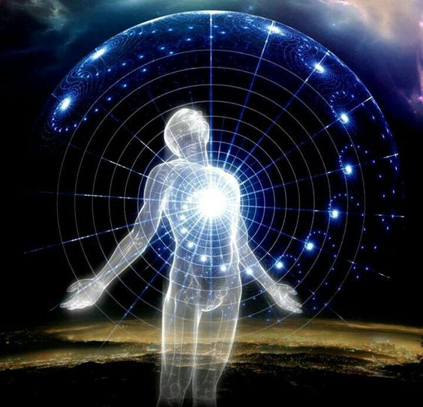
The most precious gift we ever have or ever will be given is our power of choice.
True responsibility is to act appropriately for YOU
in consequence of your choice

Slide 7
Children can only learn more ably as they experience the consequences of their choices, and have opportunity to choose again.
We are ALL children, all learning with
each choice
and its result.

Slide 8
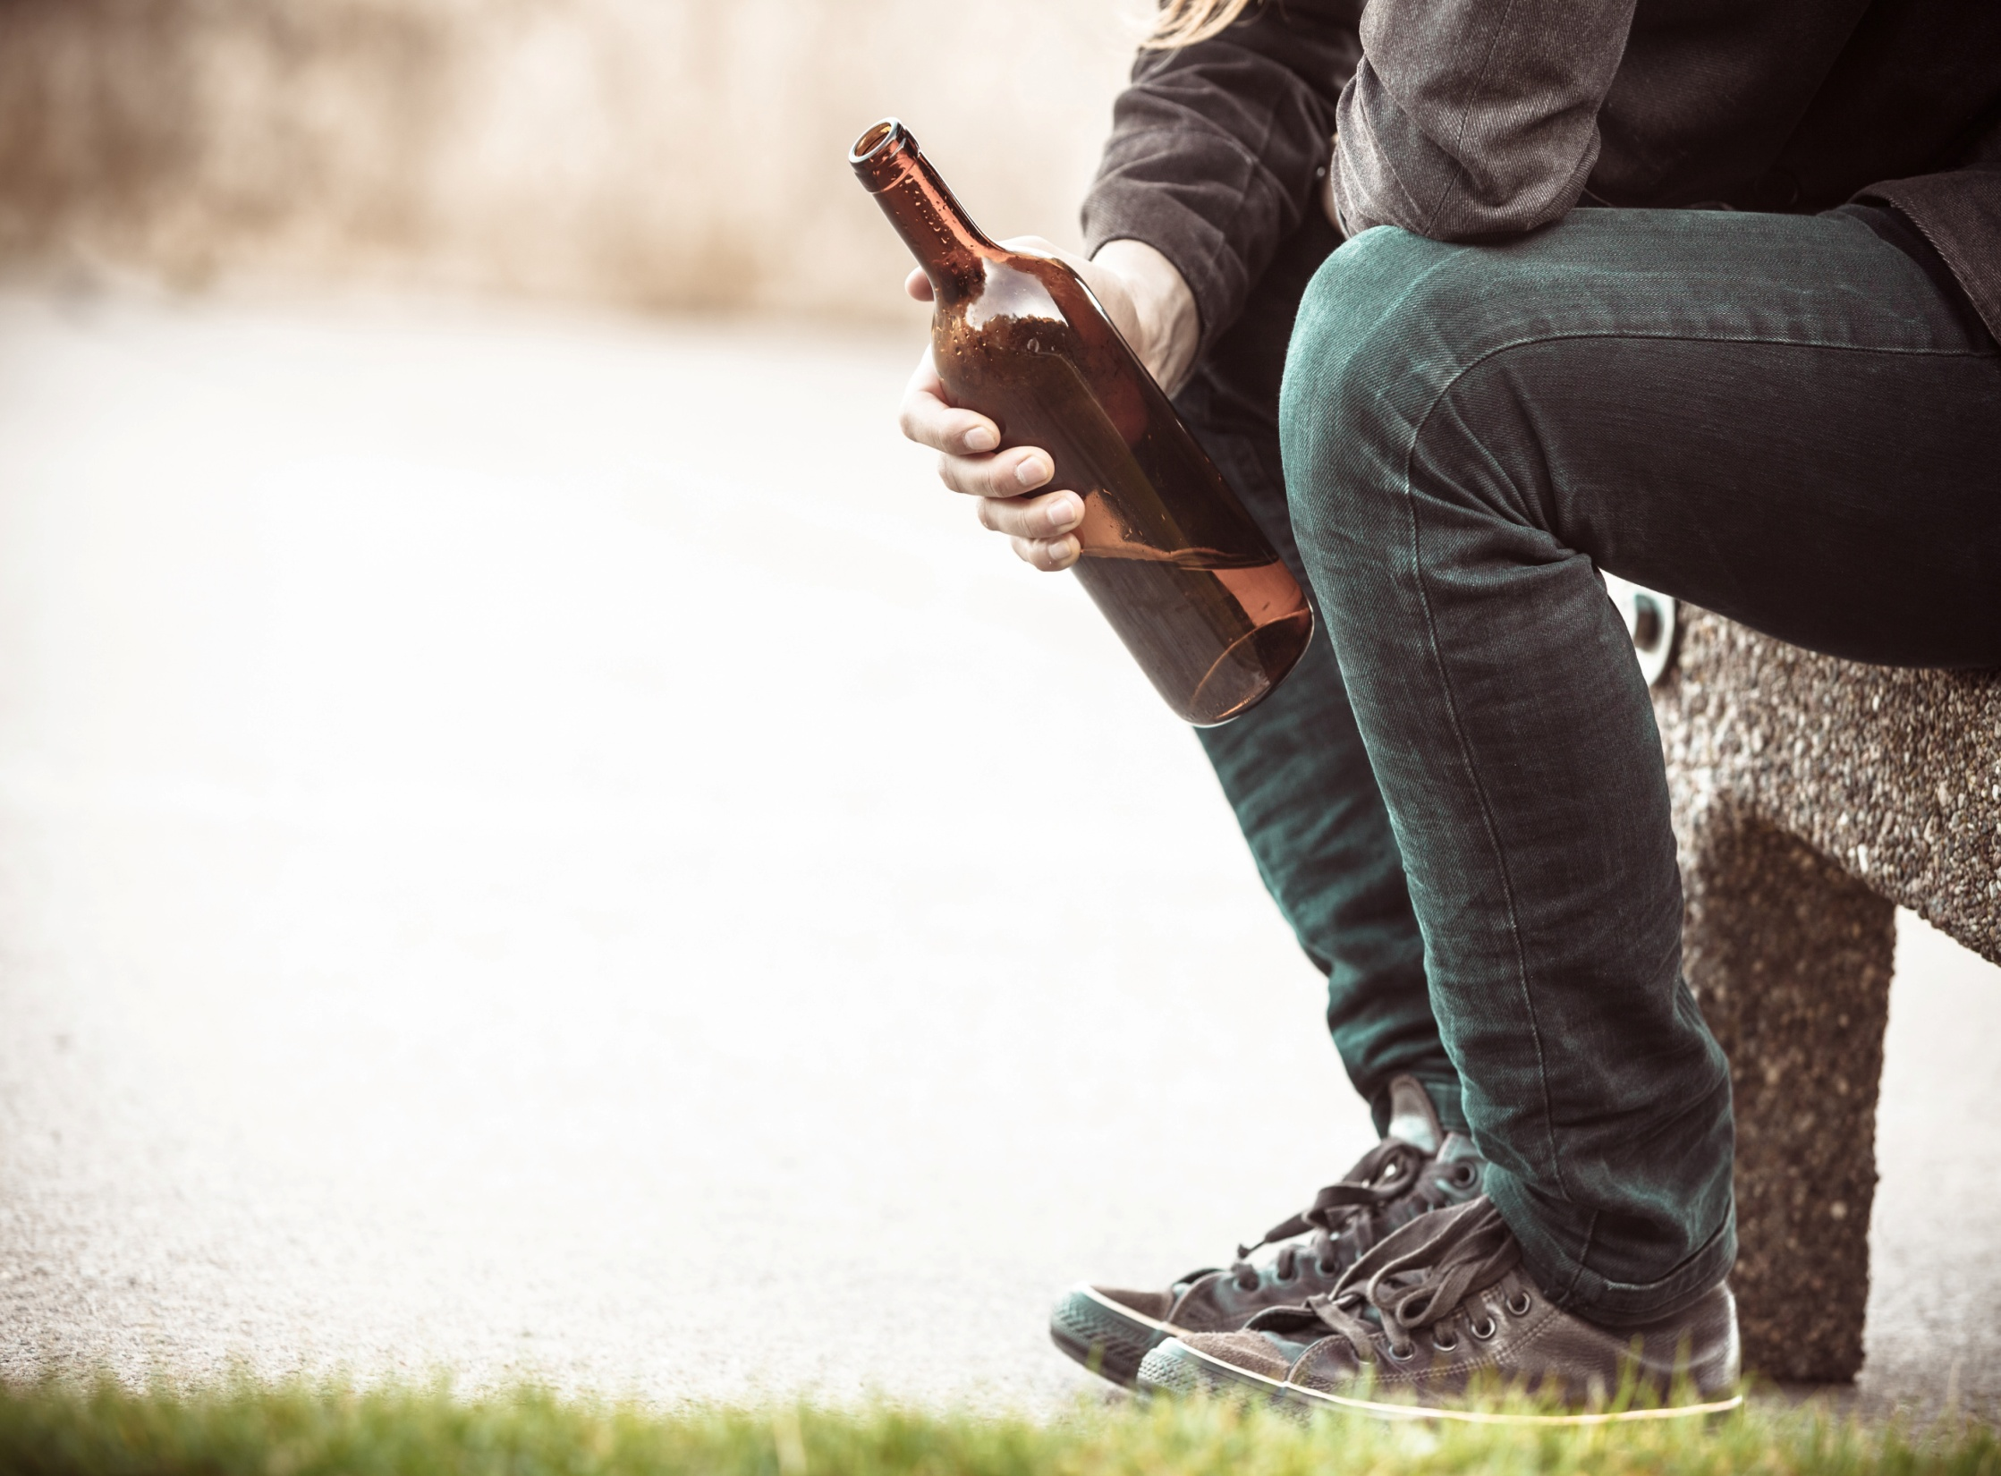
When we attempt to save others from the natural consequences of their actions, we seek to replace the Universe and its infinite wisdom with our own limited understanding

Slide 9
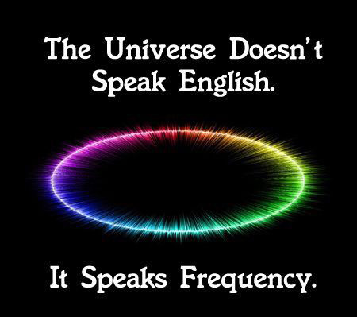
We are electro-magnetic beings

Slide 10
Choosing to stay in higher frequency vibrations
of thoughts, actions, and associations will lead us to ever higher
frequencies of joy, confidence, enthusiasm, love and feelings of success and happiness!

Slide 11
de-
prefix forming verbs and verbal derivatives
1. removal of or from something specified deforest; dethrone
2. reversal of something decode; decompose; desegregate
3. departure from
decamp
cide –
a borrowing from Latin meaning “killer,” “act
of killing,” used in the formation of compound words: pesticide, homicide.

Slide 12
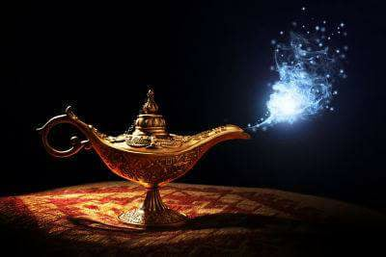
Choose,
To pick out by preference from all available, to select as to choose a wife
2. to prefer; think proper
3. to desire; want

Slide 13
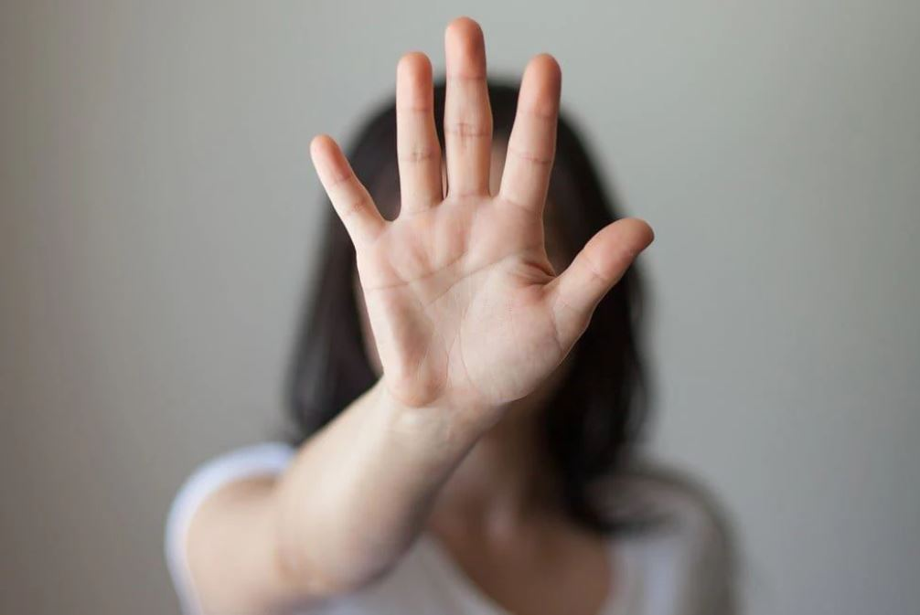
Once we DECIDE,
We must then DEFEND

Slide 14
OR…..
We can choose,
and choose,
and choose again!

Slide 16
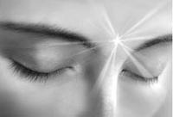
Re-cognizing patterns in our life is a first step
to choosing happiness regardless of circumstances

Slide 17
Patterns are stepping stones!

Slide 18
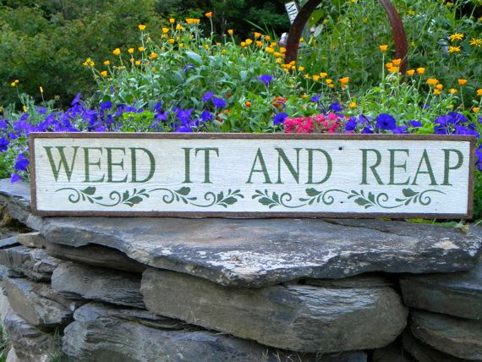

Slide 19
As are unmet expectations
Happiness is a choice

Slide 20
Cynicism is a choice. . .
Optimism is a better choice!
Shondra Rimes

Slide 21
The Pessimist sees difficulty in every opportunity
The Optimist sees opportunity in every difficulty Winston Churchill

Slide 22
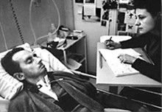
Jean-Dominique Bauby wrote a book entitled The Diving Bell and the Butterfly using his left eyelid to blink 200,000 times to choose each letter of every word of the book, taking 4 hours a day for 10 months.

Slide 23
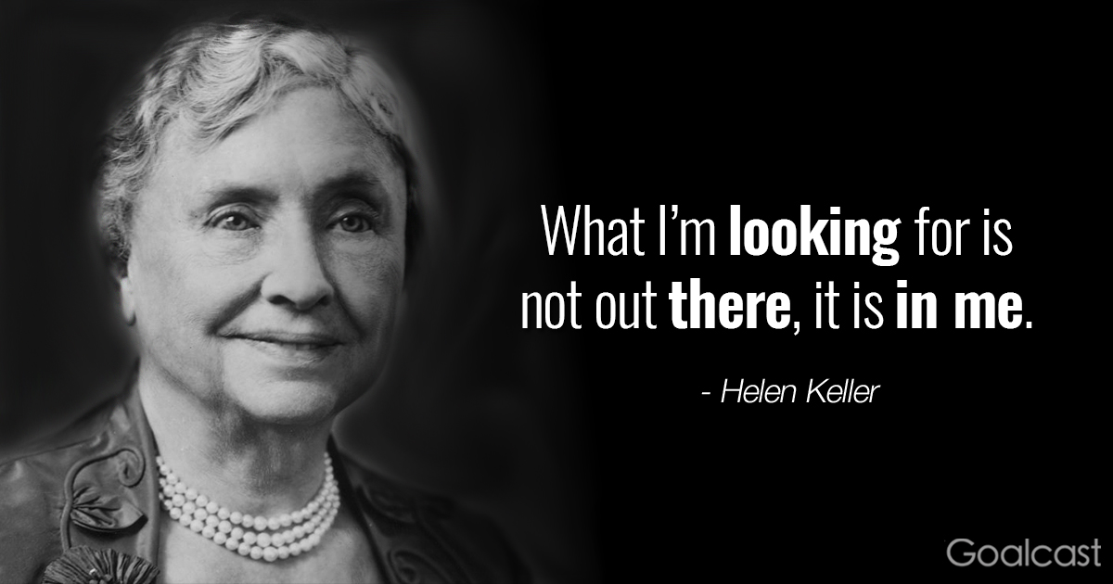

Slide 24
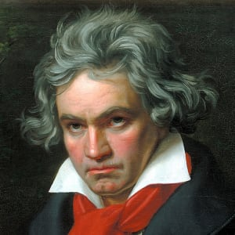
Ludwig von Beethoven began to lose his hearing at the height of his career and eventually became completely deaf. He sawed the legs off his piano so he could set it on the floor and feel the vibrations as he played. His Symphony No. 9, of which he never heard a single note, is one of his best –known works of classical music.
He overcame suicidal thoughts that overtook him at first and went on to become the musician we all know and love.

Slide 25
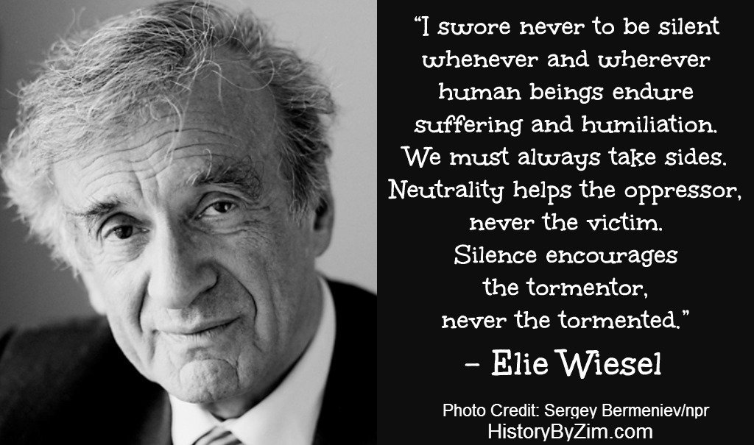
After his experience in a Nazi concentration camp, Elie Wiesel went on to spread a message of hope, atonement and peace, drawing from his own struggles to come to terms with the presence of evil in the world. He wrote over 40 books, and was awarded the Nobel Peace Price for his crusades for human dignity.

Slide 26
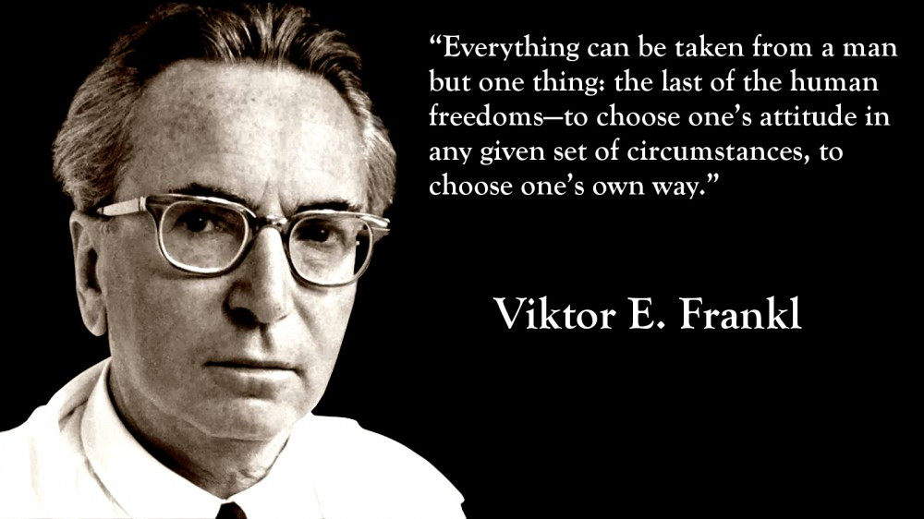
Victor Frankl went onto teach that even when we are helpless to change our circumstances, we have within us the power to live. He pioneered essential and humanist psychiatric systems and wrote more than 32 books, including his hallmark, Man’s Search for Meaning.

Slide 27
A political prisoner for 27 years, Nelson Mandela became a leader among his fellow inmates, fighting for better treatment, better food and study privileges, earning his B.A. while imprisoned. Elected president of South Africa, he received more than 250 awards, including the Nobel Peace Prize. His funeral was a global event.

Slide 28
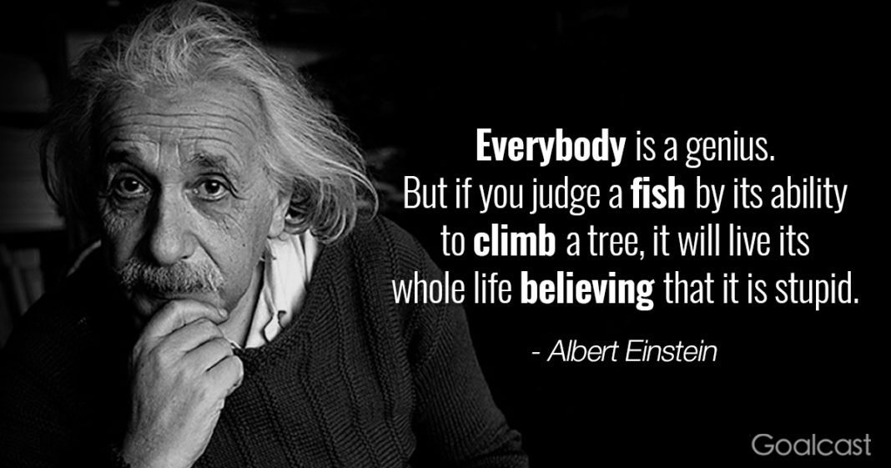

Slide 30
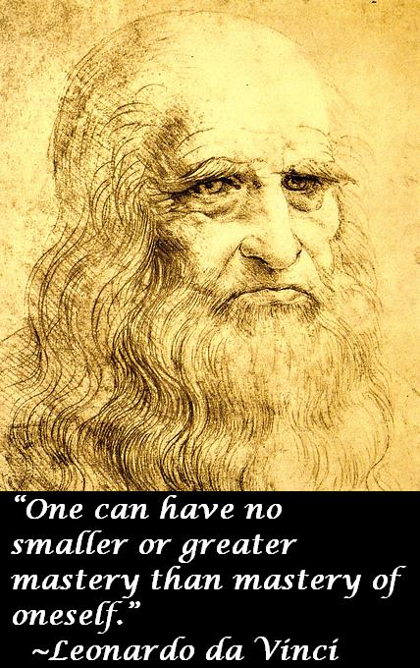
Albert Einstein, Alexander Graham Bell, Leonardo da Vinci, Thomas Edison, Walt Disney and Winston Churchill are all said to have displayed signs of learning disabilities like dyslexia.
They did poorly in school. They were told they were stupid talentless, unteachable and that they would never amount to anything beyond ‘mediocre.’

Slide 31
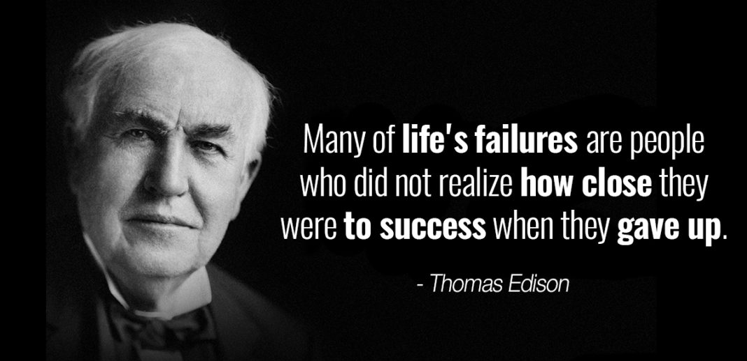
In addition to failing about 10,000 times before landing on a successful design for the light bulb, his factory burnt to the ground when he was 67, destroying countless lab records and millions of dollars of equipment. When he surveyed his losses, he remarked, “There is great value in disaster. All our mistakes are burned up. Thank God we can start anew.”

Slide 32
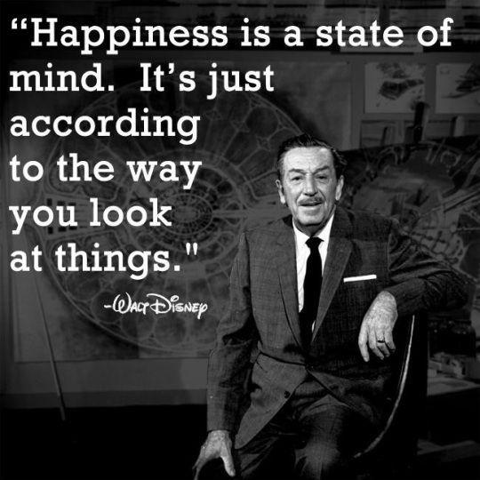

Slide 35
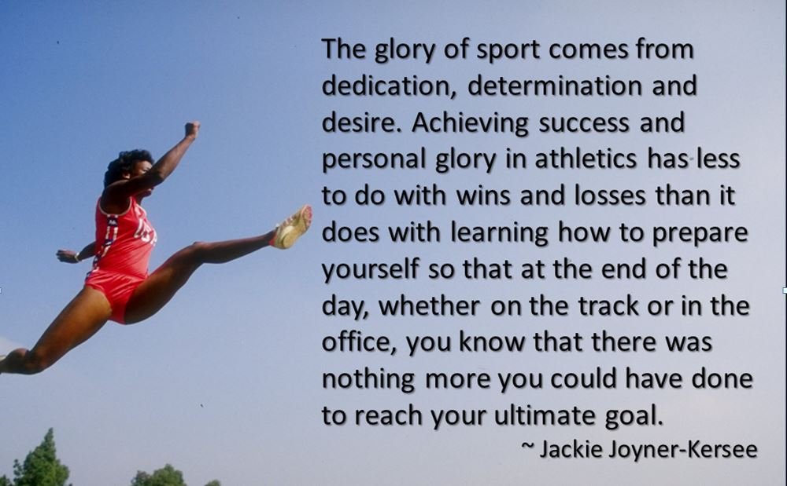
Jackie Joyner-Kersee was diagnosed with asthma when she was 18. She is now six-time Olympic medalist in track and field, is ranked among the all-time greatest athletes, and was named by Sports Illustrated for Women as the Greatest Female Athlete of the 20th Century.

Slide 36
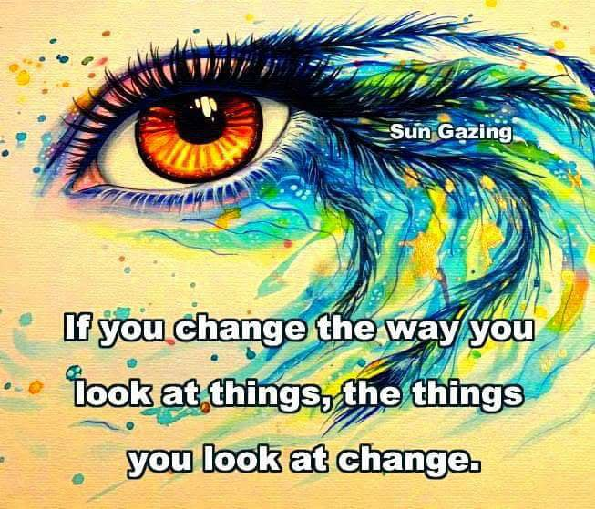

Slide 37
