Slide 1
Skills for Life
The Second Half of the Rapid Eye Model

Slide 2
This presentation created by Julia Fairchild with loving Aloha

Slide 3
The Principle of Harmony and Rhythm
“He who lives in harmony with himself lives in harmony with the Universe”
Marcus Aurelius

Slide 4
Cymatics illustrates the harmony and rhythm of the universe. Check out this amazing video.
Notes:
link to video on this slide
https://www.youtube.com/watch?v=Q3oItpVa9fs
https://blog.pachamama.org/healing-sounds-of-the-universe
https://www.futuresymphony.org/the-music-of-the-spheres-or-the-metaphysics-of-music/

Slide 5
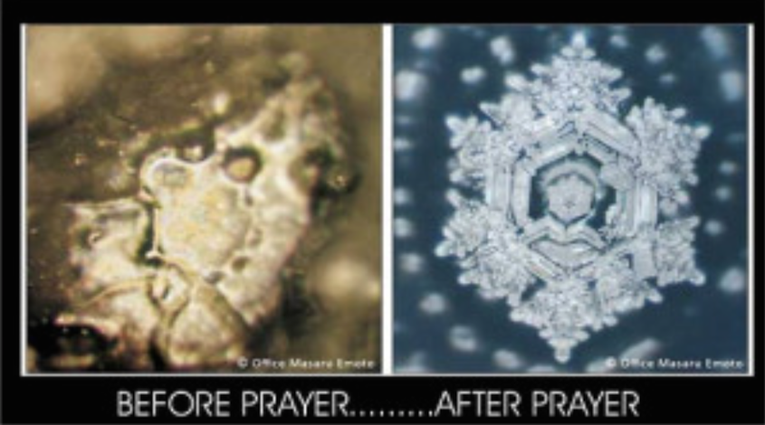
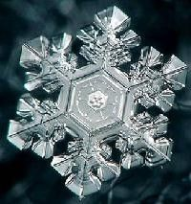
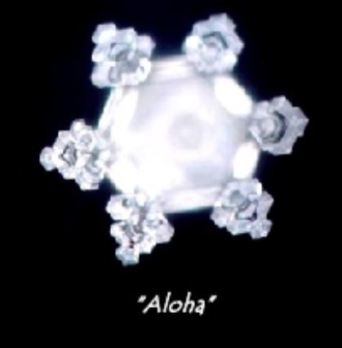
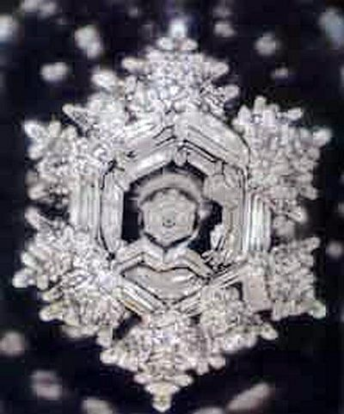
This phenomenon is also illustrated in Dr. Masaru Emoto’s work with water crystals
Notes:
https://paradigmshyft.com/2019/04/22/10-signs-you-are-raising-your-vibration-and-ascending-your-consciousness/

Slide 6
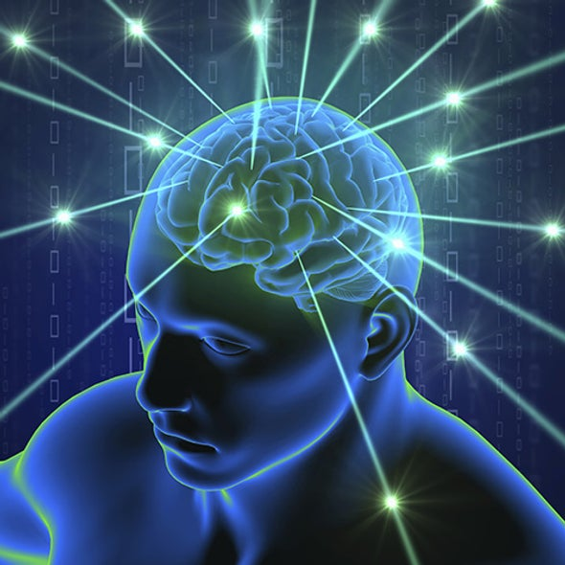
As illustrated by sound vibrations, and by thought vibrations creating patterns in the water/ice, our thoughts are also a vibratory force, and attract or repel matter in the same ways, arranging our lives into the circumstances we create around us.

Slide 7
Circum (around) stance (stand) Circumstances are the conditions that stand around us, magnetized to us by the central core of our thought forms. Change the thoughts at the center of the energy field, and we change the conditions that stand around us.

Slide 8
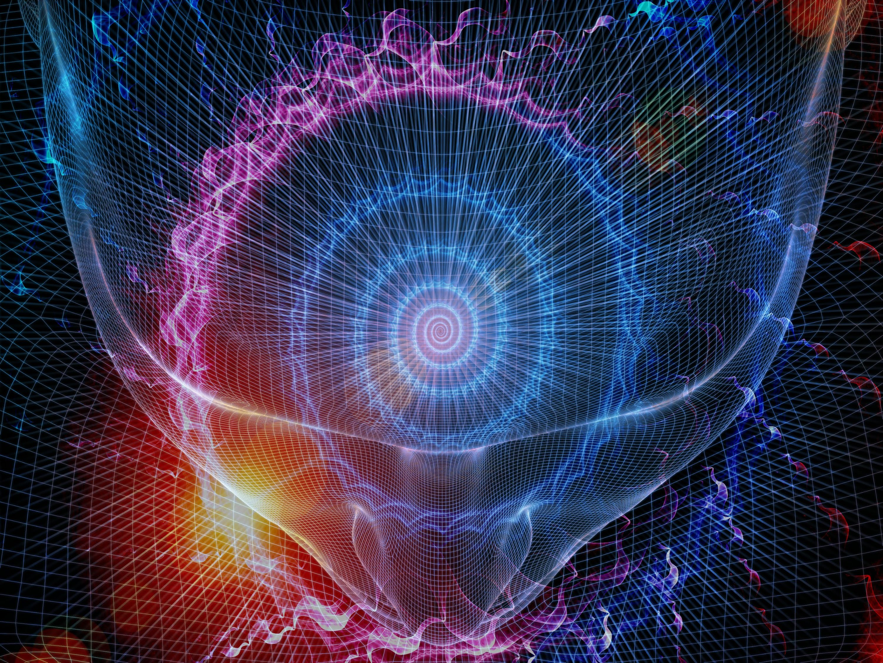
There is a basic rhythm to all Creation, including us. As we can hear the sound of electricity along the telephone wires, we can also hear a resonant hum within our own being, if we can be quiet enough to listen. It can be heard in the right ear.

Slide 9
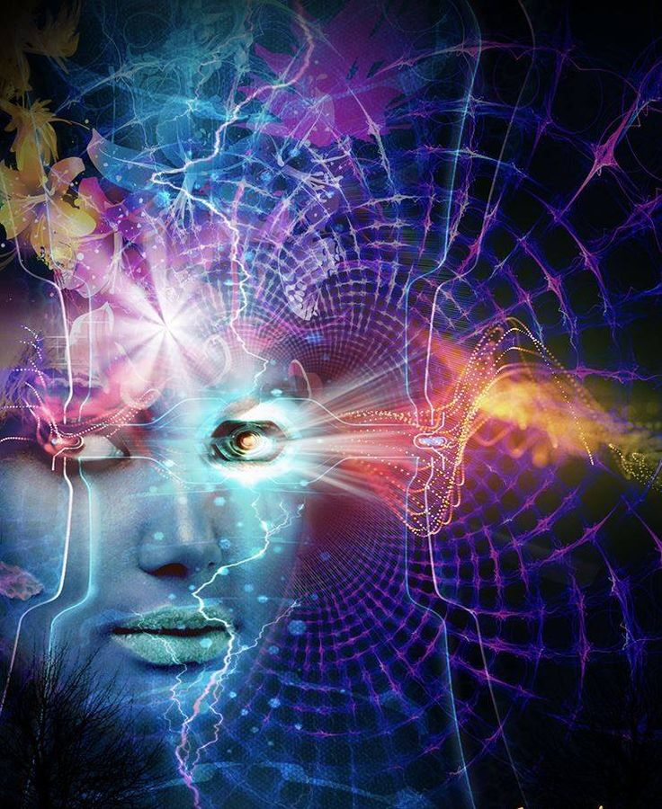
Meditation and visualization improve the ability to hear, feel, and become more sensitive to our inner self and the world around us.

Slide 10
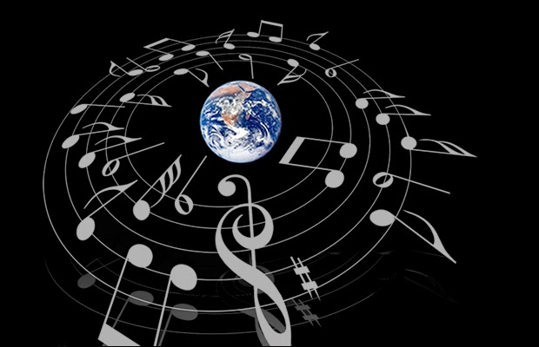
Music is a portrayal of the harmony and rhythm of the entire universe. While music is mathematical, it is also emotionally powerful
Notes:
https://sellfy.com/magneticminds/

Slide 11
Likewise, though not visible to us except as in how our lives show up, the
Laws of the Universe
are as dependable as math,
and we can count on them to serve us as we obey the principles

Slide 12
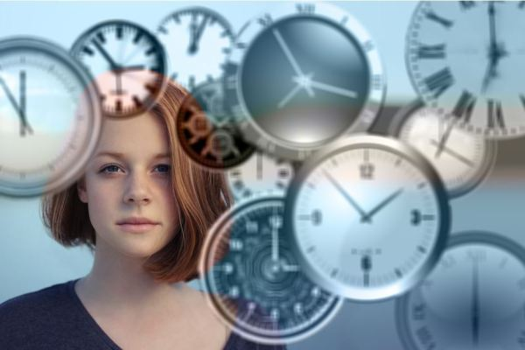
Two clocks (or a dozen) ticking in the same room, will come to tick in unison – all on the same beat.
Likewise, if you listen to those two clocks and the sound of your own heartbeat, you will find that they beat together as well.

Slide 13
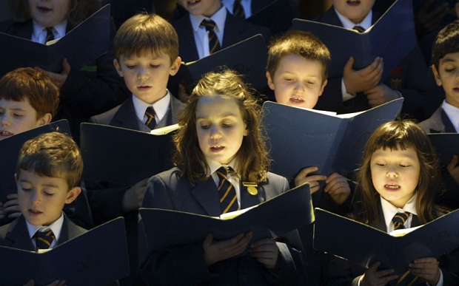
Singing together, and other activities that bring breath into coherent unison, is also proven to synchronize heartbeats as one.

Slide 14
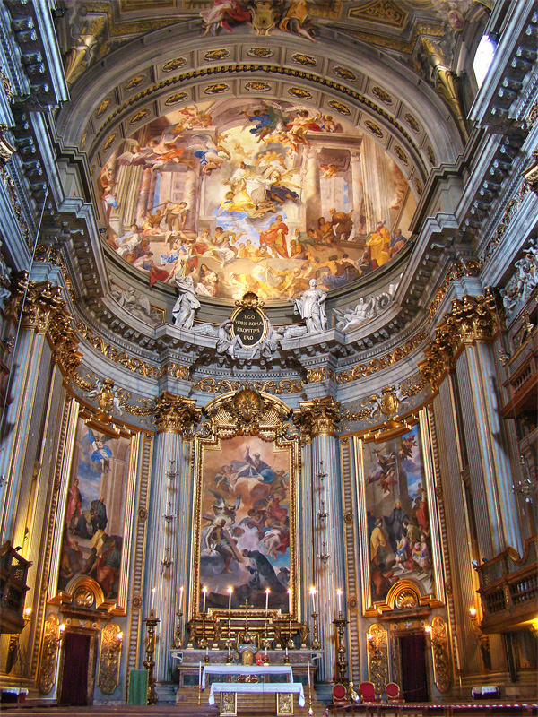
Baroque music can enhance memorization because it also beats to the rhythm
of the heart and of the earth,
as it matches the beats of the clocks ticking together as one.

Slide 15
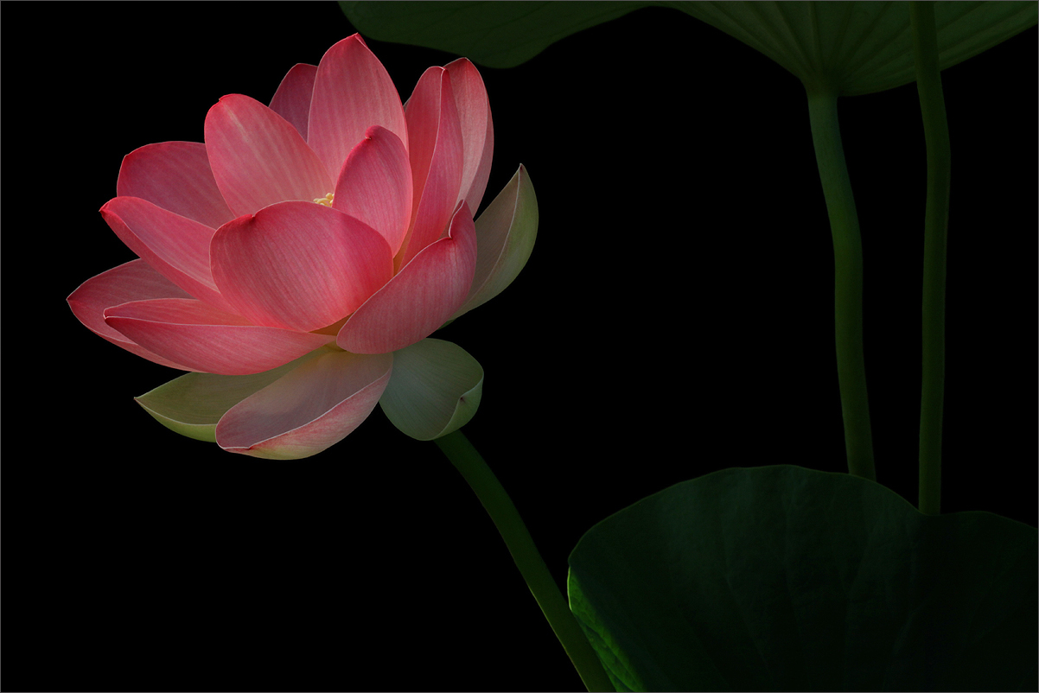
To increase our own harmony and rhythm, we can increase our understanding of the information we receive from our senses,
our intuition,
and our
awareness of energy.
We can be more awake!

Slide 16
Thought
Perception
Cause
Effect
Accountability
Choice
Gratitude
Abundance
sad
Healing
Health
Harmony
Rhythm
When we are in harmony with these principles, we draw upon the powers of Nature or Heaven.
We are aware that all is in harmony and
all things work together for our good.

Slide 17
CONSIDER THE DIFFERENCE
BETWEEN
A REACTION AND A RESPONSE

Slide 18
When someone gets triggered,
someone gets ‘shot’!
How do you stop a bullet?

Slide 19
Between stimulus and response
there is a space.
In that space is our power
to choose our response.
In our response lies
our growth
and
our
freedom.
Viktor E. Frankl

Slide 20
One helpful exercise might be to WAIT, take a deep breath, and ask. . .
WHY
AM
I
TALKING?

Slide 21
When we react,
we are giving away our power.
When we respond,
we are controlling ourselves.
Bob Proctor

Slide 22
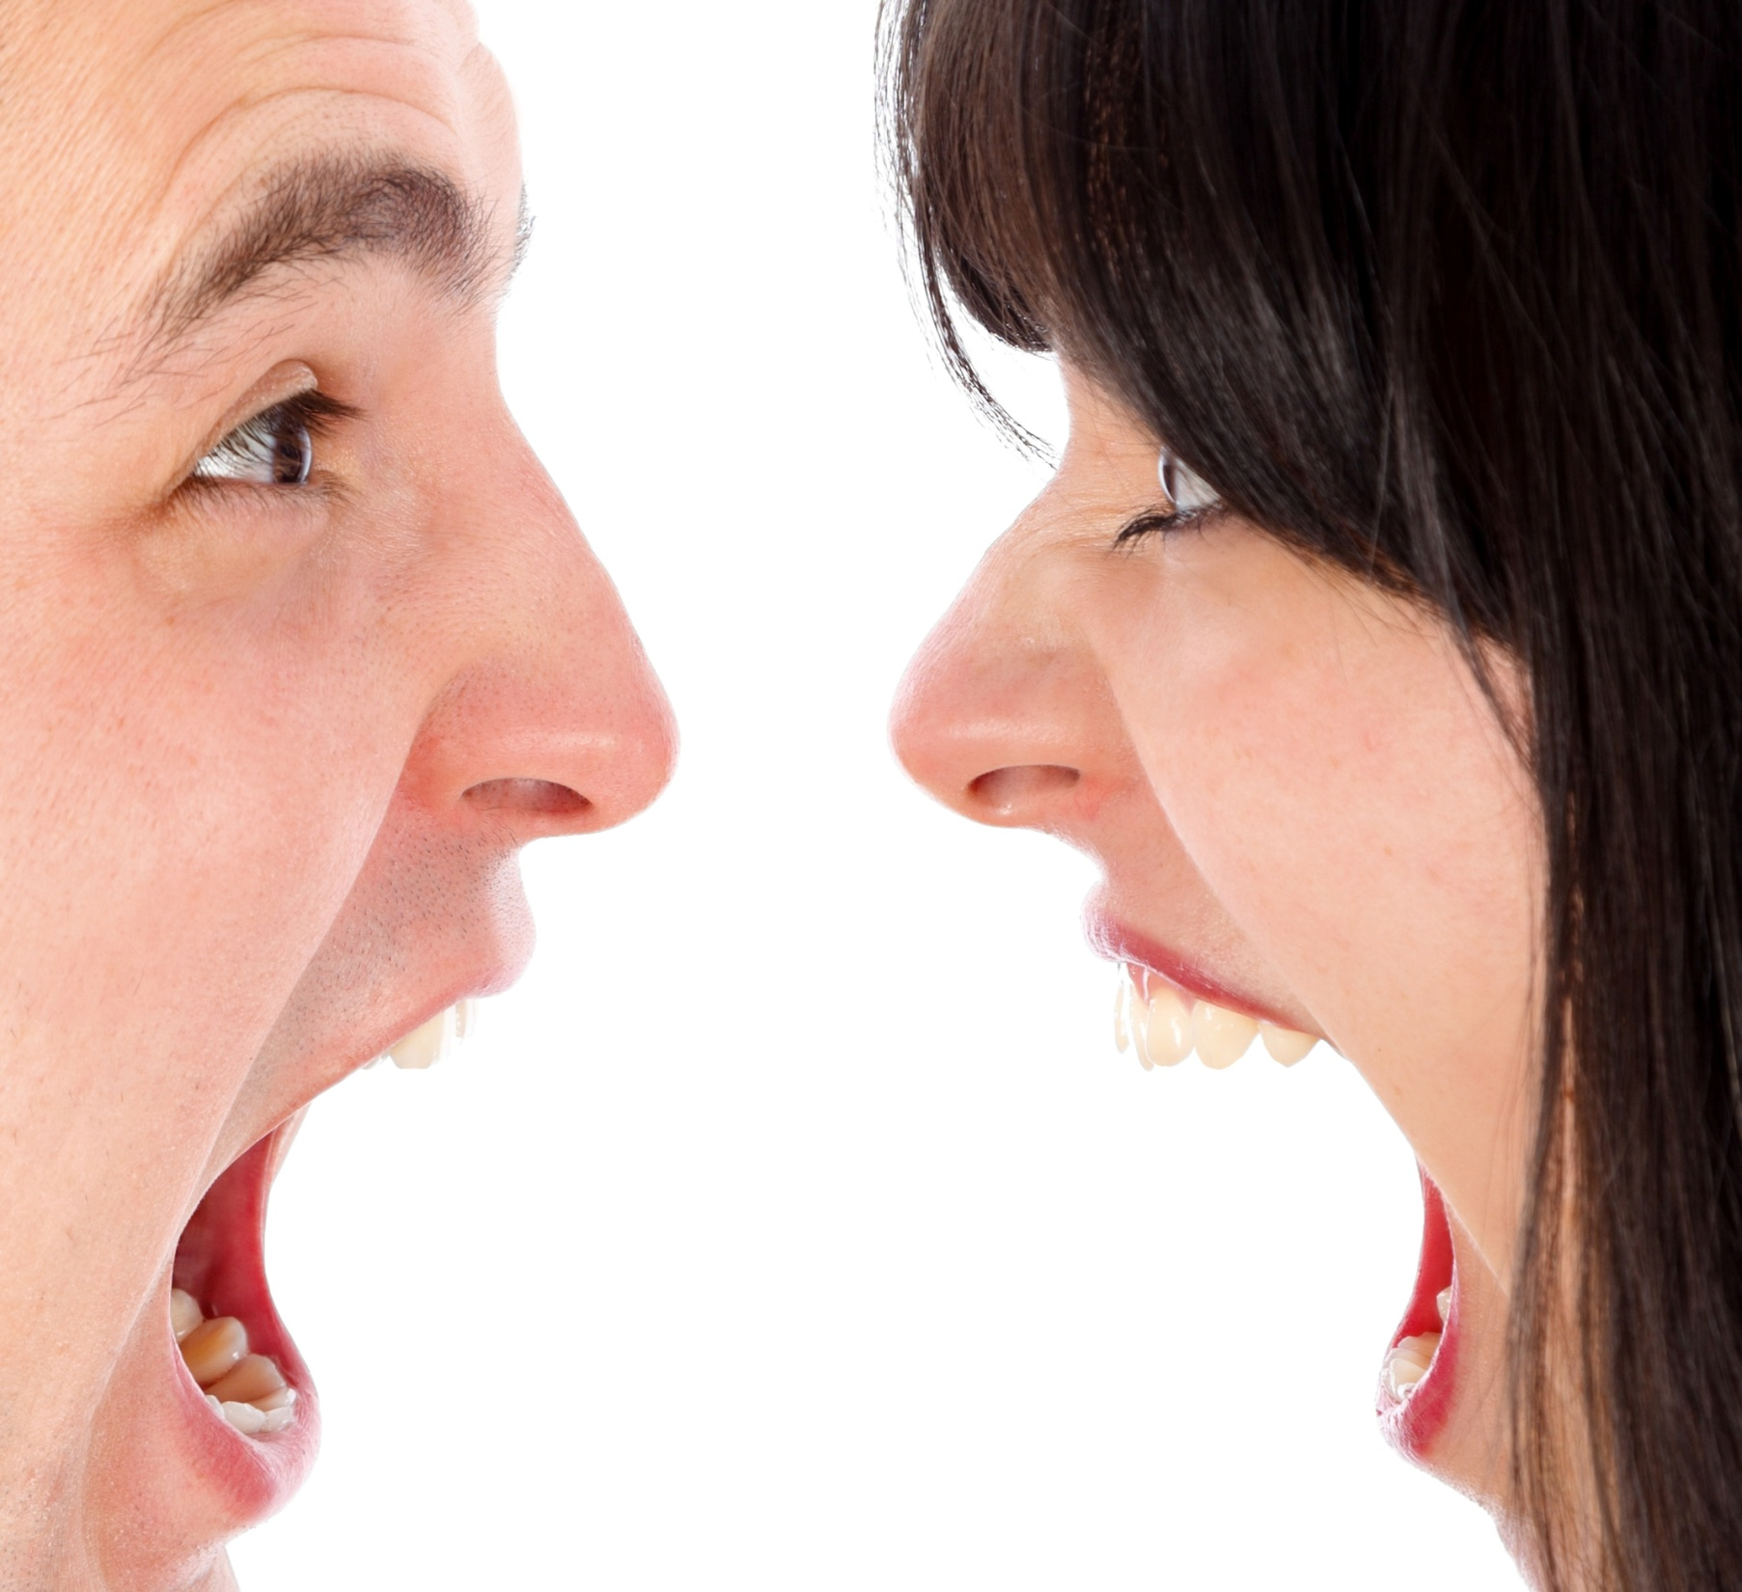
Reacting
to mirror
anger, confusion, anxiety or fear
in another
encourages them
to believe
they are presenting the
truth

Slide 23
Another response is to disregard the illusion and remember the other as
perfect and joyful,
or better,
see him as perfect in his innocence,
much like we view a child having a tantrum.
The more we come to love ourselves,
the more
we are able
to remain centered
in compassion
for others.

Slide 24
When a child takes an unreasonable stance, we hopefully are able to see beyond the moment, keep our own cool, and seek to discover and meet the needs of the child, no matter how ‘badly’ they are acting
or reacting
to the circumstances around them.
We take their inherent worth for granted.

Slide 25
In fact, we are all ‘children’
who can misbehave from time to time

Slide 26
As we have compassion for these lapses in ourselves and one another, we can contribute to greater and greater peace and harmony among us. Remember to
BREATHE!

Slide 27
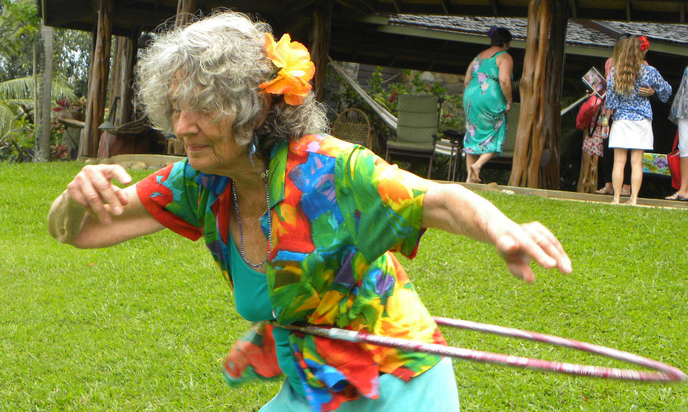
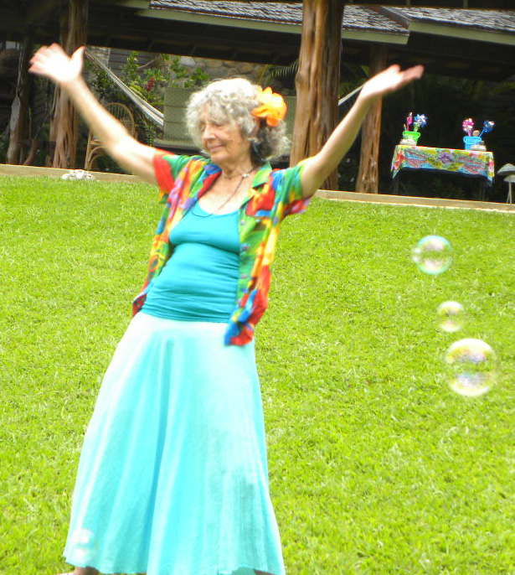
This ability to draw conditions to ourselves has tremendous
practical
implications.
It means we can use our thoughts to create the life we want.
It means we really can change for the better.
It means that things no longer have power over us, for we realize that they are simply manifestations of our own thoughts -- thought forms reacting to the signals we project.

Slide 28
This principle is possibly best expressed in the magic of music.
Besides harmony, rhythm and melody, the best music contains
the frequency of
LOVE!
And this is more than a lovely sentiment! It’s science. . .

Slide 29
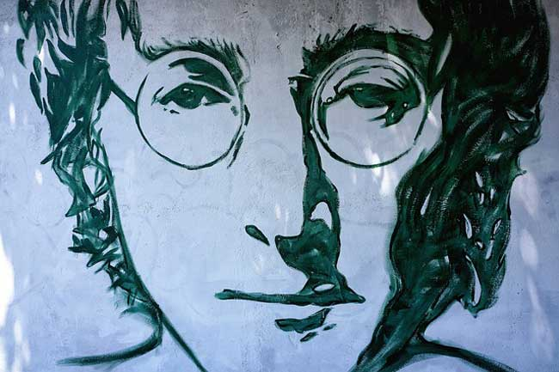
The 528 Hz frequency is the most significant of the ancient Solfeggio Frequencies. (look it up) Known as the “love” frequency, it has a deep-rooted relationship with nature, and is present in everything from chlorophyll to human DNA. It also has mathematical significance and proven healing potential.
Perhaps the most famous song composed in 528 Hz is John Lennon's Imagine.
Notes:
https://www.mindvibrations.com/solfeggio-frequencies-use-guide/
https://www.mindvibrations.com/solfeggio-frequencies/
The late Dr. Candice Pert, an American neuroscientist and pharmacologist who discovered the opiate receptor, and the cellular binding site for endorphins in the brain, said that the energies and vibrations of these frequencies affect us on a cellular level, opening our chromosomes and exposing the DNA.

Slide 30
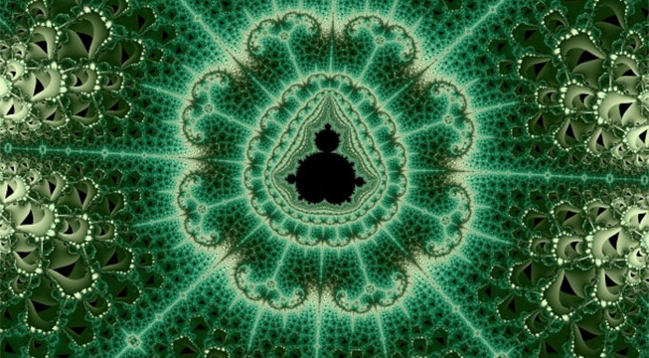
When music contains this element, it performs miracles. It sets into motion natural forces which begin a tumbler-like action -- a turning of the tide of the lives of people.
Research into the science of sound, or vibration, helps us understand that creating music requires interaction between right/left brain, transcending the mind and going directly to the heart.
Notes:
https://en.wikipedia.org/wiki/Mandelbrot_set
The Mandelbrot Set is a mathematic computation which is said to be the boundary between chaos and order. It’s WAY more complicated than that, as you can see on this Wikepedia reference page
AND, it beautifully illustrtes that mathematics is about divine order, as is music – they all follow universal laws

Slide 31
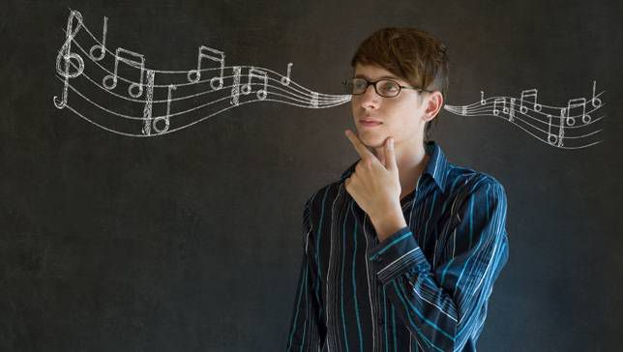
Making music, (through voice or instrument) is a powerful tool to help one grow by developing an ability to organize creative thoughts and express them effectively.
The combination of notes, and patterns of Baroque music creates order in the brain, much like a computer files data in an orderly way for later retrieval.

Slide 32
What does order have to do with it?
To CREATE is to ORGANIZE that which is unorganized. Chaos is necessary to the process of creation ~ and without organization, all remains in chaos, and creation fizzles.

Slide 33
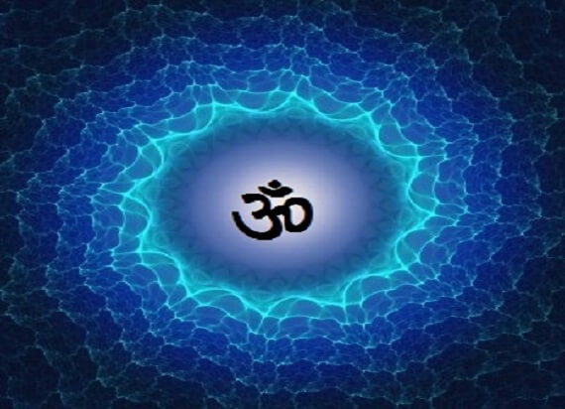
Another form of sacred sound well known to raise the vibratory experience of all who practice it is MANTRA. Both Hebrew and Sankrit languages are vibratory in nature, and not linguistic. In other words, the seed sounds of Sanskrit VIBRATE the frequency of that concept, i.e. healing, abundance, love, etc., as opposed to spelling it out in symbols of the alphabet.
Notes:
NOTES FROM THE CD SERIES: Mantra : Sacred Words of Power By Thomas Ashley-Farrand
This link is to a PDF of information accompanying the CD series: http://download.audible.com/product_related_docs/SP_TRUE_000406.pdf
Powerful and beautiful mantras are available. Here are a few of my favorites.
https://www.youtube.com/watch?v=AmsPdQlEy2c&t=322s
https://www.youtube.com/watch?v=K8_ye06fIns
https://www.youtube.com/watch?v=8BSKPele2Vo&list=PLAc-BddUn3iqTCNTO6FRIRDZ7smw1UNtj&index=7
https://www.youtube.com/watch?v=kYivP3gedCo&list=PLAc-BddUn3iqTCNTO6FRIRDZ7smw1UNtj&index=3
https://www.youtube.com/watch?v=7IJ4nNzbkcY&list=PLU4A8LsnefqUkUFPh5RtRDz9dI5L9Br_4&index=27
In order to derive maximum benefit from your mantra practice, you will
find it helpful to understand some basic concepts underlying the mantra
principle.
1. Mantras are energy-based sounds.
Mantra derives its power from the energy effect its sounds produce.
Pronouncing a mantra creates a particular physical vibration, in the form of
sound, that creates various effects in both the physical and subtle bodies.
2. Mantras are chakra-based sounds.
The fifty letters in the Sanskrit alphabet correspond to the fifty petals
traditionally depicted on each of chakras one through six (from the base
of the spine to the brow). When a Sanskrit mantra is uttered, the petals
corresponding to the letters in the words of the mantra vibrate in spiritual
resonance, energizing the petal, which then becomes tuned to a higher energy
state. Ambient spiritual energy is attracted to the person pronouncing the
mantra, producing a net gain in usable spiritual energy.
3. Mantra focused with intent increases its effect.
Intention – or the reason we are saying the mantra – is superimposed on
the physical vibration, increasing and strengthening the effect of mantra
practice.
4. Mantras have only an approximate language-based translation.
The true nature of a mantra is the experience that it ultimately creates in the
individual who chants it. All who chant the mantra will arrive at a similar
experiential definition.
5. Mantra energizes prana.
In Eastern traditions, prana is a basic form of life energy that is capable of being
transferred between individuals. When we pronounce a particular mantra
while visualizing an internal organ bathed in light, the power of the mantra
and the prana become concentrated in that organ, with beneficial effect.
6. Mantras are energy that can be likened to fire.
The same fire can cook your lunch or burn down the forest. Similarly,
mantras produce spiritual energy of great intensity. There are powerful
mantra prescriptions not even taught in the West; but those taught in this
program are perfectly safe to use on a daily basis.
7. Mantras eventually quiet the mind.
Used over a protracted period of time, mantra quiets the myriad random
and incoherent babblings of the subconscious mind. The dedicated use of
mantra can dig into crystallized thoughts stored in the organs and glands and
transform these bodily parts into repositories of peace.
Intense mantra activity can sometimes also be disconcerting. Imagine trying
to clean a swimming pool with several inches of mud accumulated on the
bottom. The very act of putting a suction hose on the bottom of the pool and
turning on the motor will cause the muck to swirl up into the clear water
above. Clarity will be temporarily obstructed as the water appears to become
dirtier than it was before. This is similar to some effects produced by the
intense use of mantra.
The New Testament, Gospel of John, starts: “In the beginning was the Word . . . .” Light was not the beginning. Rather, it was sound, in the form of divine speech. Neither the Old nor the New Testament contains a verse saying, “And God made light to shine. . . .” Instead, God creates the phenomenon by speaking it. “And God said, ‘Let there be light.’” The primary mechanism of creation is sound.

Slide 34
“You
are a part
of the Universe,
no less than the stars and the trees, and you have a right
to be here.
And whether it is clear to you or not, no doubt
the Universe
is unfolding
as it should. . .”
Desiderata

Slide 35
As part of the cosmic Universe, our lives are governed by universal laws.
We need to keep a balance, as does all of nature
We take time to grow and time to heal
Our lives will always move in cycles
We need time to rest and recuperate, as do all living things

Slide 36
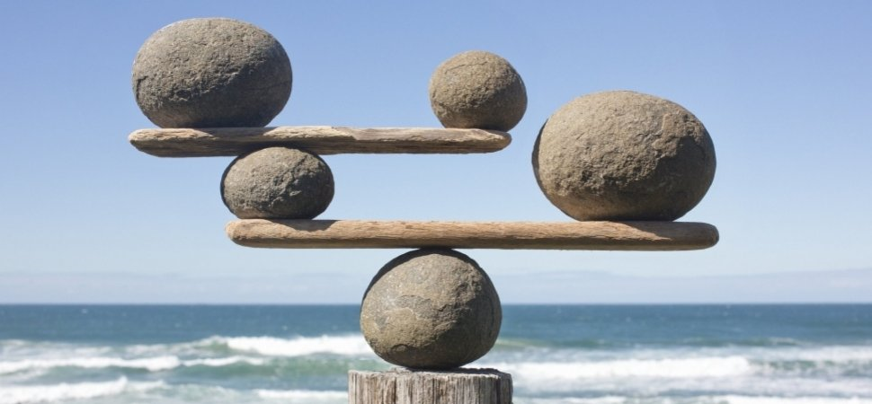
Keeping a balance in life, on every level, begins with waking up, learning to choose thoughts and words skillfully, learning how to respond rather than react, and keeping the bigger picture in sight.

Slide 37
Real healing and growth take time
There are very few instant or overnight successes
Inner work is a lifestyle

Slide 38
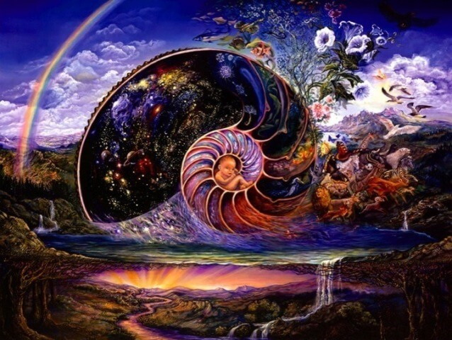
All of life is lived in cycles. Cycles within cycles. We can endure our winters because we are promised the Spring. And so they revolve again for every generation. Wisdom evolves as the cycles return, and we are always learning, growing, and evolving.

Slide 39
Learn to rest, to rejuvenate, to re-create. Take time to ponder, to review, to just BE.
Constant frenetic action and work is not as productive as coming back with a fresh start from time to time.

Slide 40
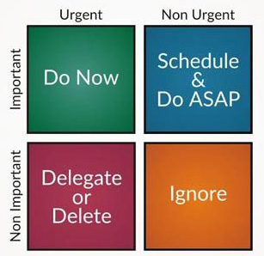
Assess your priorities
Listing those things which are important to you, take time to assess how much time you are spending to meet your goals and purposes.
This will change as your life circumstances, your family obligations, your work, etc., change.
Re-assess as often as you need to maintain balance and a feeling of success and accomplishment.

