Slide 1
Skills for Life
The Second Half of the Rapid Eye Model

Slide 2
This presentation created by Julia Fairchild with loving Aloha

Slide 3
The Principle of Abundance & Gratitude
What You Love/Fear Today
You Live Tomorrow!

Slide 4
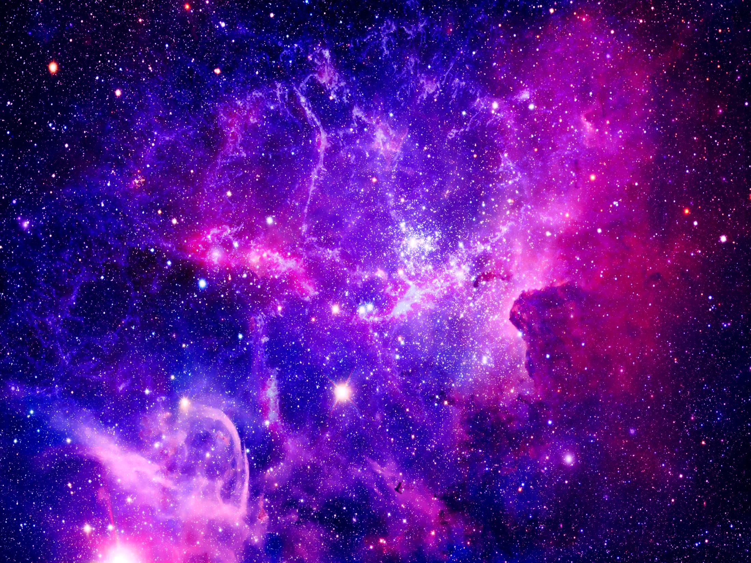
Abundance is the Natural State of the Universe
We always receive what we believe in abundantly

Slide 5
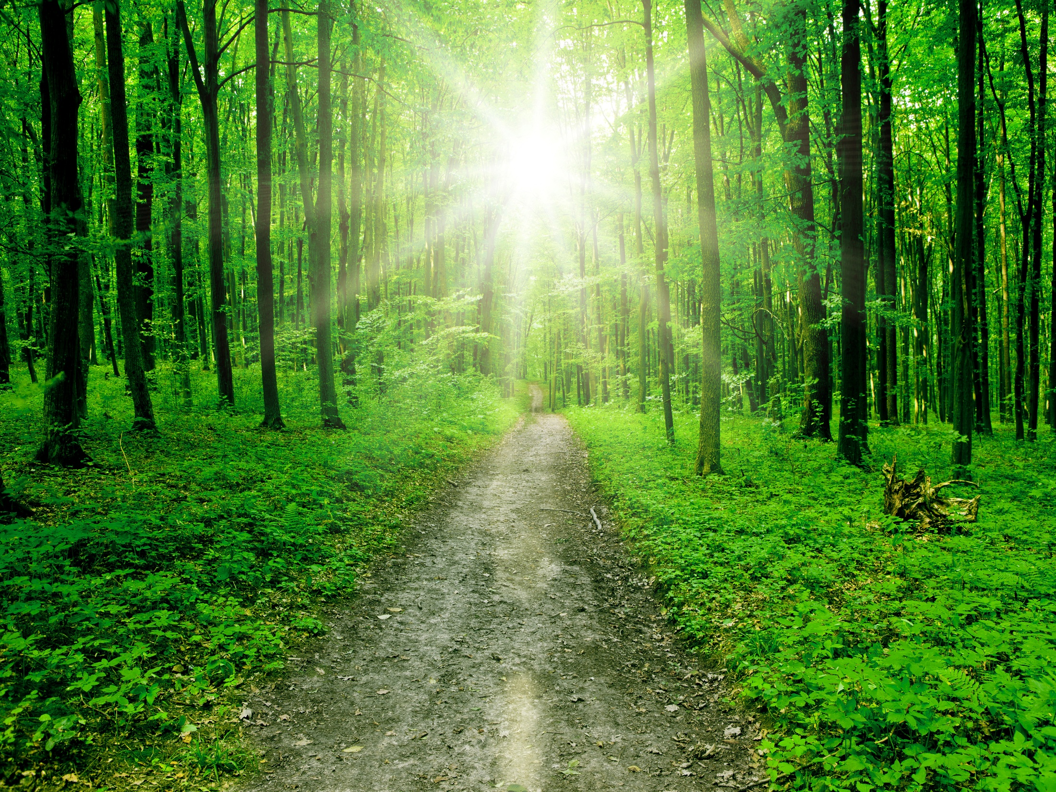
We are always experiencing abundance.
Abundance of WHAT is determined by what we believe we are worth.

Slide 6
Abundance is merely the Universe’s response to our thoughts and emotions.
We think and feel
and the Universe
provides experience or form
in abundance
to assist us in thinking and feeling

Slide 7
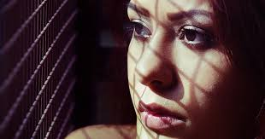
What
we
focus
upon ~ grows!

Slide 8
We live in a dimension of fluid creation
It is full of energy
Some energy is potential, awaiting insructions

Slide 9
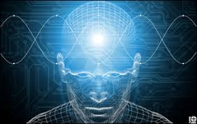
Potential energy is potential creation
Gratitude is the focusing of attention upon a thought or emotion, which brings the thought into physical manifestation. Thereby, we experience physically all that we feel gratitude for
Energy is activated as we focus attention upon it. This is the Principle of Gratitude

Slide 10
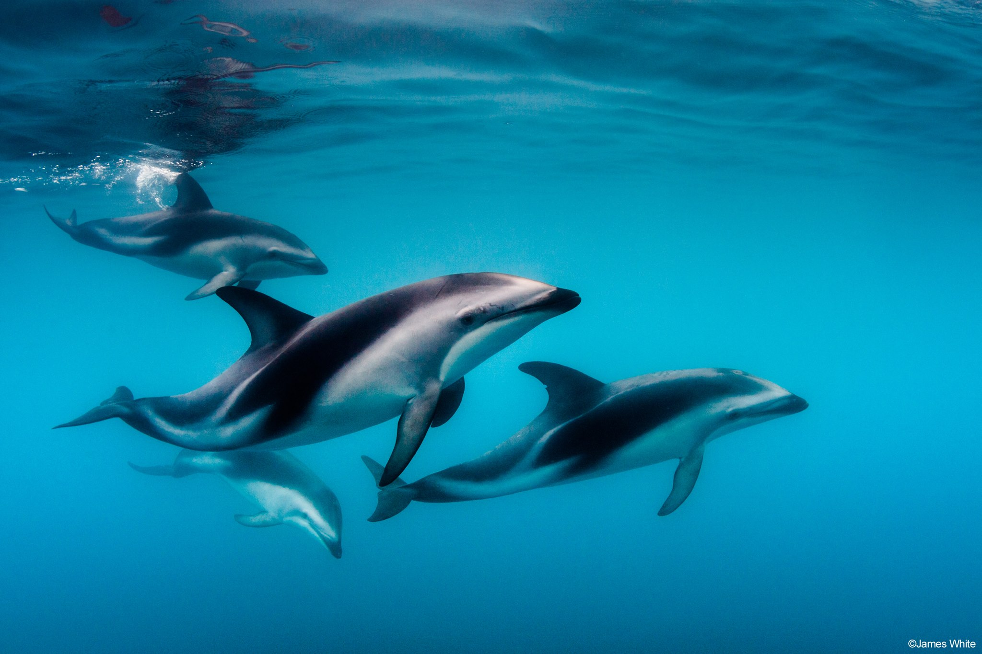
To enjoy abundance in our lives requires only a willingness to recognize that it is our natural state

Slide 11
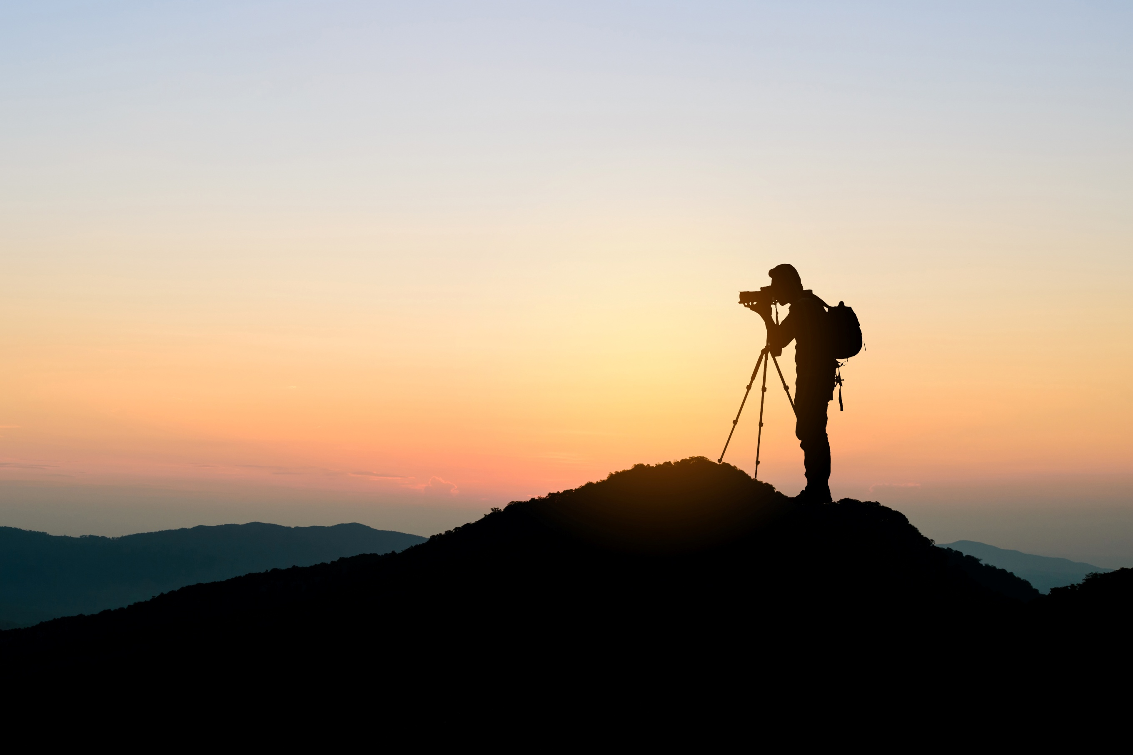
When we choose to make doing what we love the core experience in our life, we move into alignment with the Universe

Slide 12
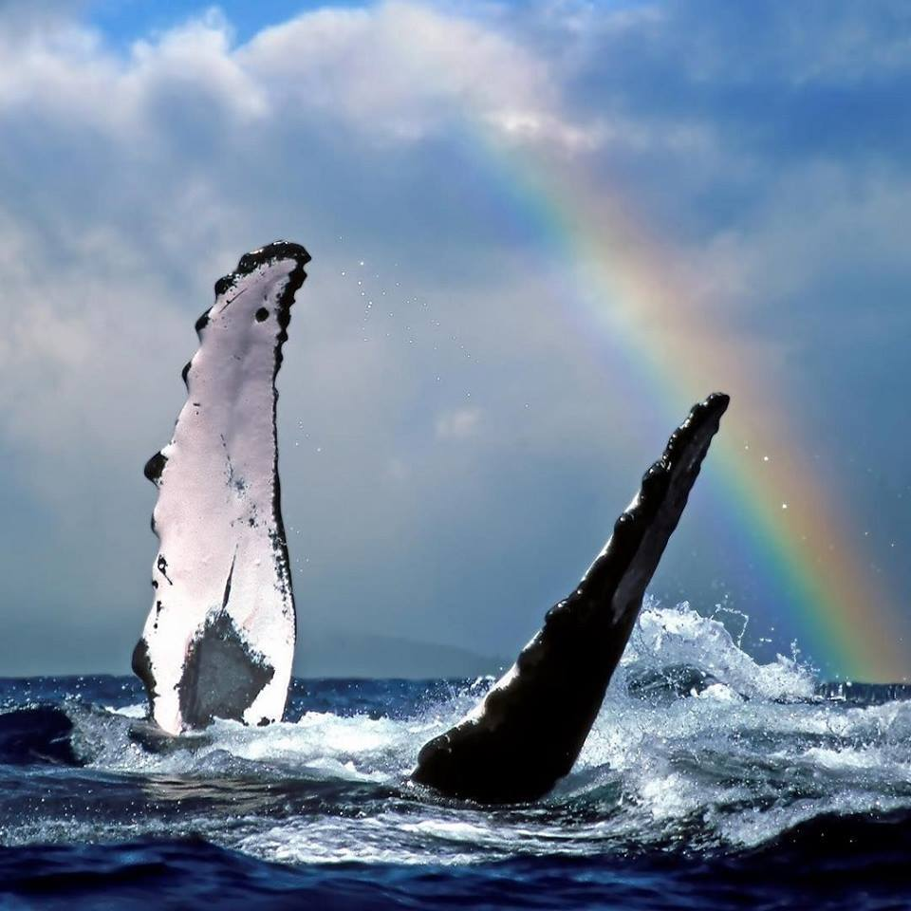
Immediately, the infinite supply of energy is made available
We begin to feel the aliveness that comes with gratitude

Slide 13
And these same good feelings are felt by the people we come in contact with

Slide 14
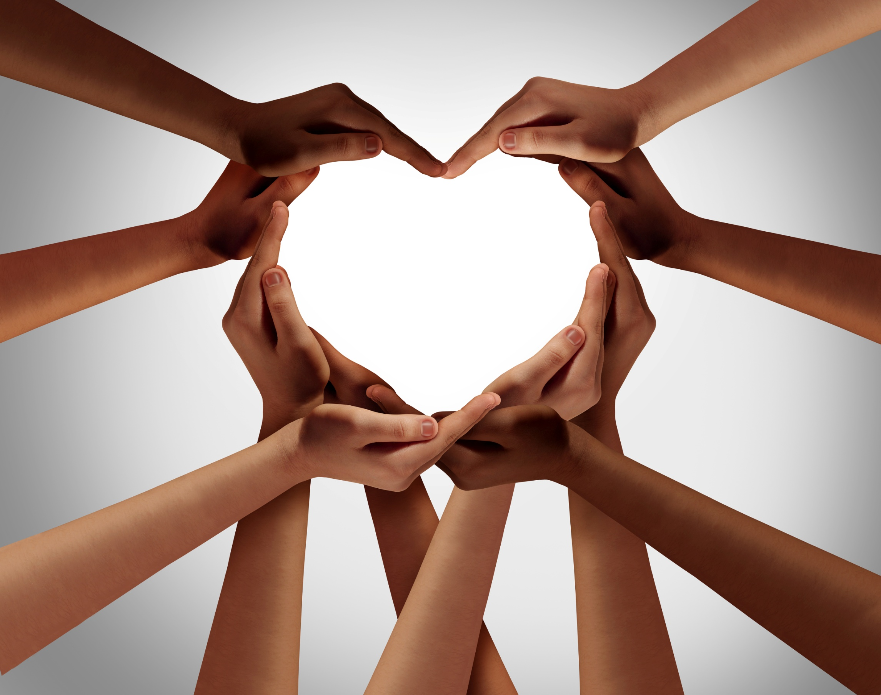
The people and circumstances that support us are attracted
to us

Slide 15
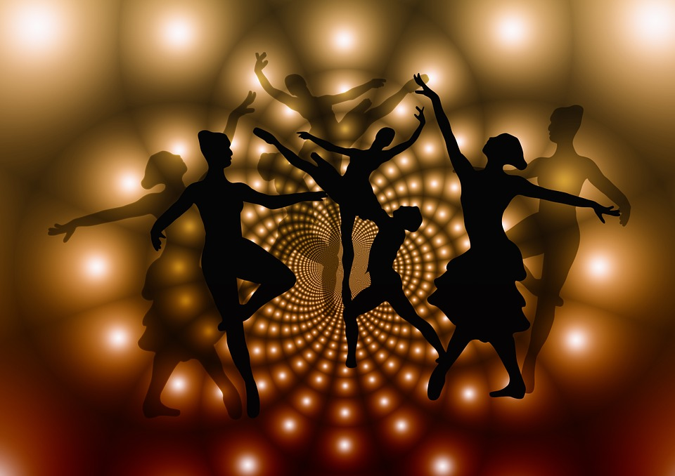
Perception
Cause
Effect
Thought
Choice
Accountability
Gratitude
Abundance
Health
Healing
Harmony
Rhythm
The connection this principle has with all the others is a demonstration of the interconnections we all have,
to our abundance

Slide 16
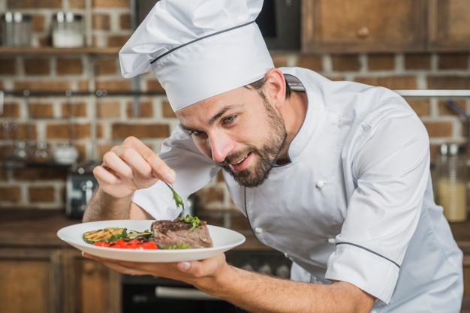
ATTRACTION
As we do what we love, we direct energy into high quality goods and services

Slide 17
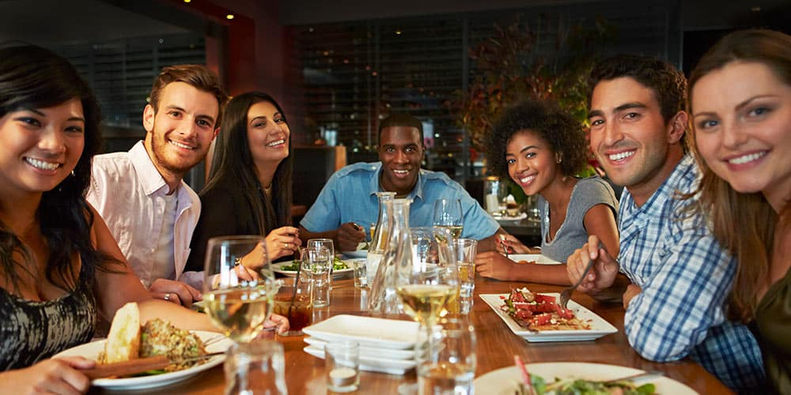
The people we attract are the ones who will help us by buying our products and services and recommending them to others.

Slide 18
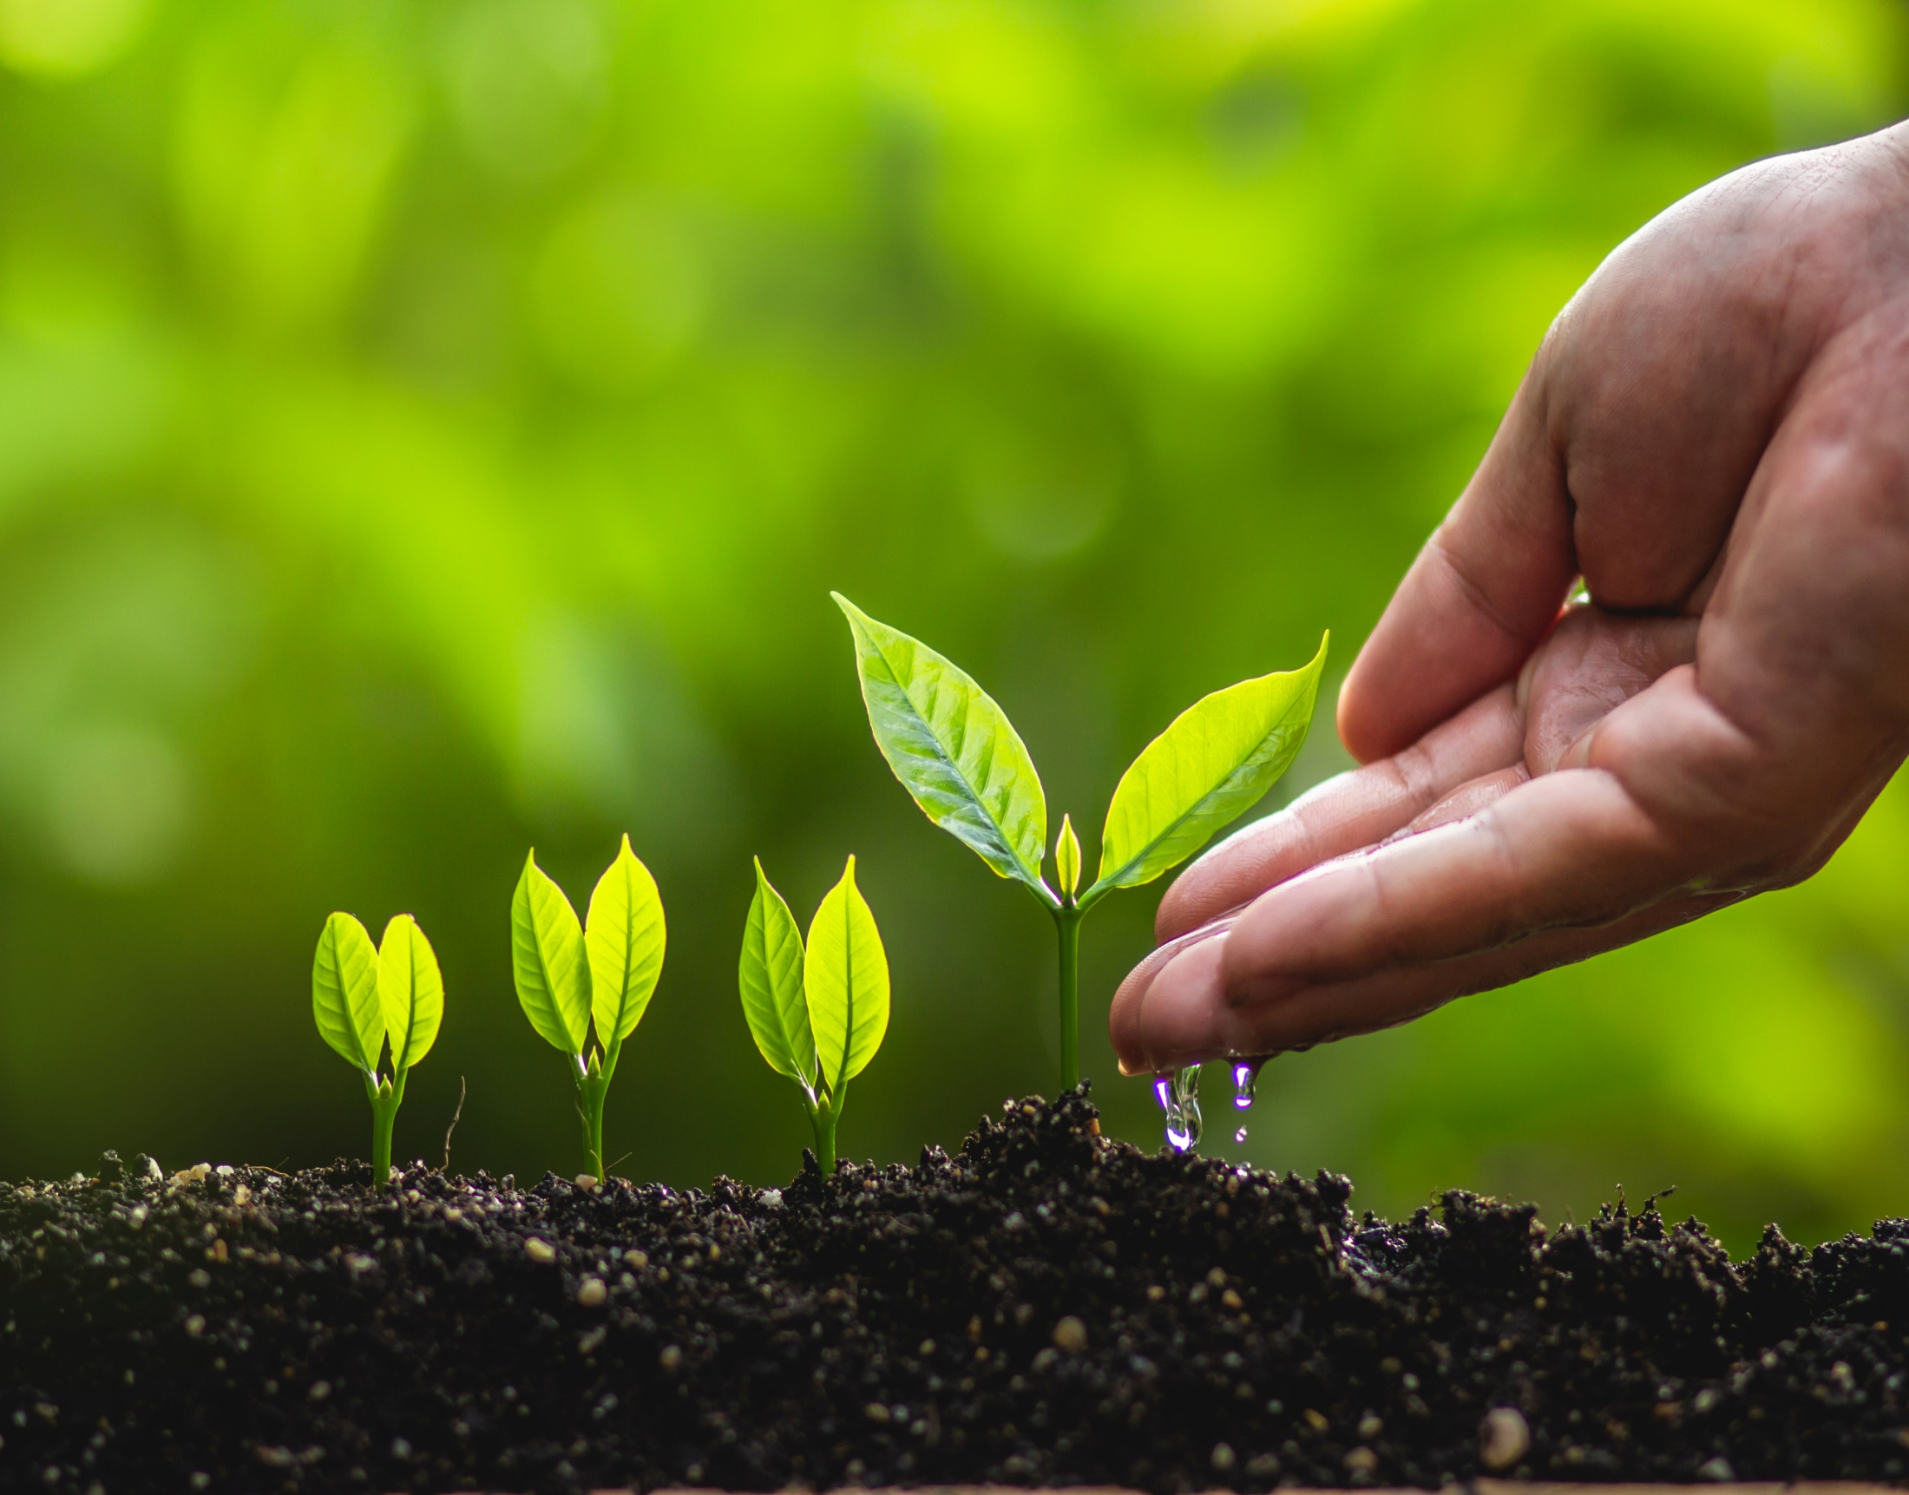
Think of your focused self love and gratitude as sunshine and rain on the invisible seed, and then the tiny seedling of your desired outcome

Slide 19
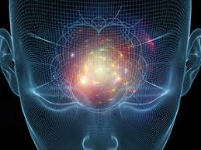
Gratitude
is the focusing of attention
upon a thought or emotion,
which brings the thought
into physical manifestation
Thereby, we experience physically all
we think and feel gratitude toward
or focus attention upon

Slide 20
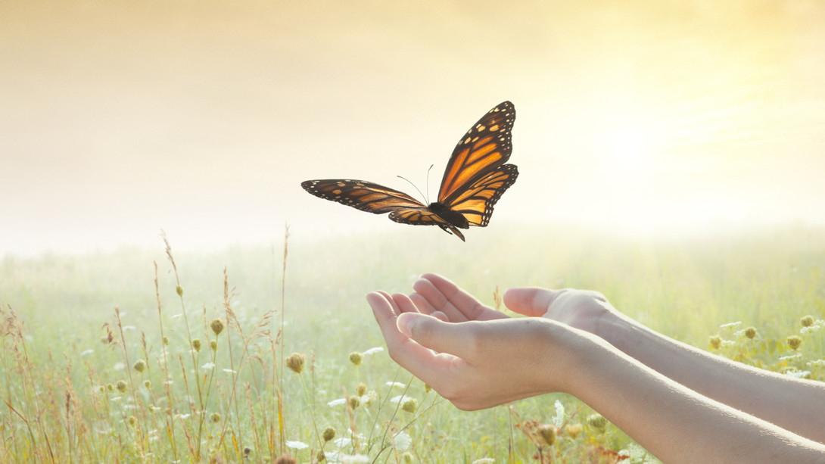
RELEASE
Crucial to attracting what we want, is release of what we used to have or no longer want. We must let go of old things in order to make room for and embrace the new.

Slide 21
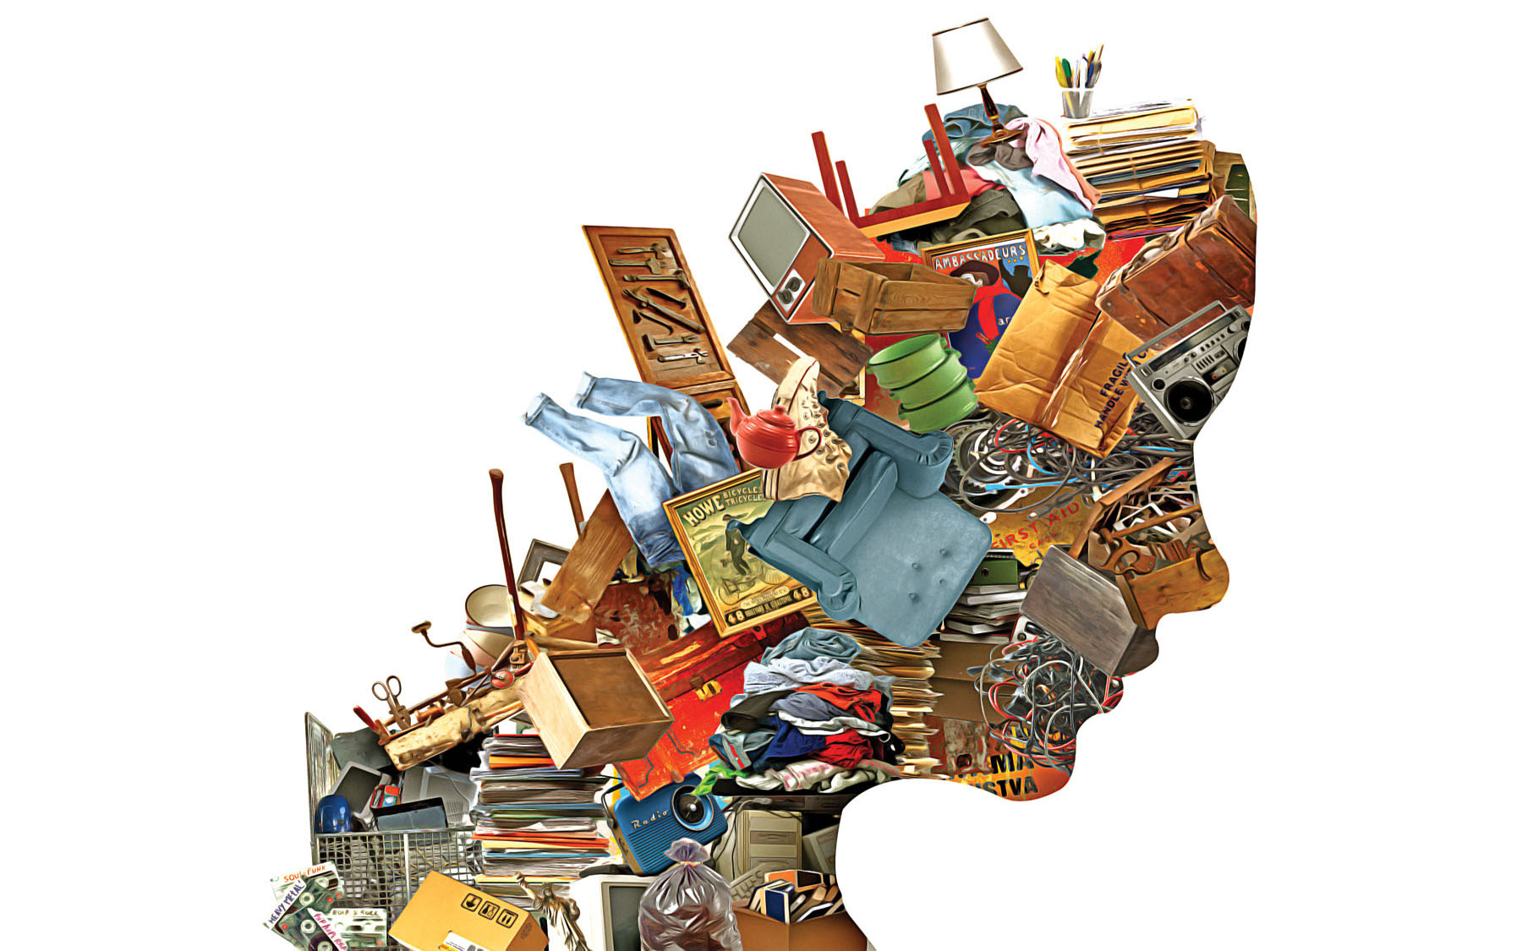
When we hang on to the old and outmoded, we create blocks & stagnation.
Physical
Emotional
Mental
Spiritual

Slide 22
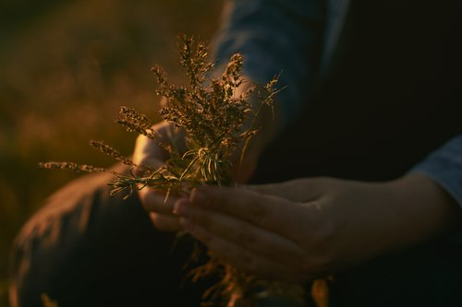
“Holding on to anything is like holding your breath.
You will suffocate.
The only way to get anything in the physical universe is by letting go of it.
Let go and it will be yours forever.”
Deepak Chopra

Slide 23
Reflecting on the past is helpful if we can learn from the experiences, and change the way we feel about them to FORGIVENESS and GRATITUDE for giving us the opportunity to learn and grow

Slide 24
We ALL Deserve Great Abundance in our Lives

Slide 25
Self Love
is
Universally our
Greatest
Challenge
If every person could love themselves completely, every being on the planet would have enough of every thing they ever needed or wanted.
Lack of self love is the root of all evil

Slide 26
EVIL is LIVE spelled backwards. Any thought, word or action that turns its back on living fully, abundantly, with health, wealth, love and wisdom, can be called evil.

Slide 27
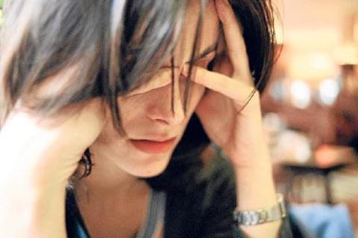
Lack of any kind in life is a direct message that we are failing to love ourselves. Loving ourselves will heal and change our lives.
It will also allow us to consciously direct tremendous abundance in our lives. Gratitude is the key to directing abundant energy.

Slide 28
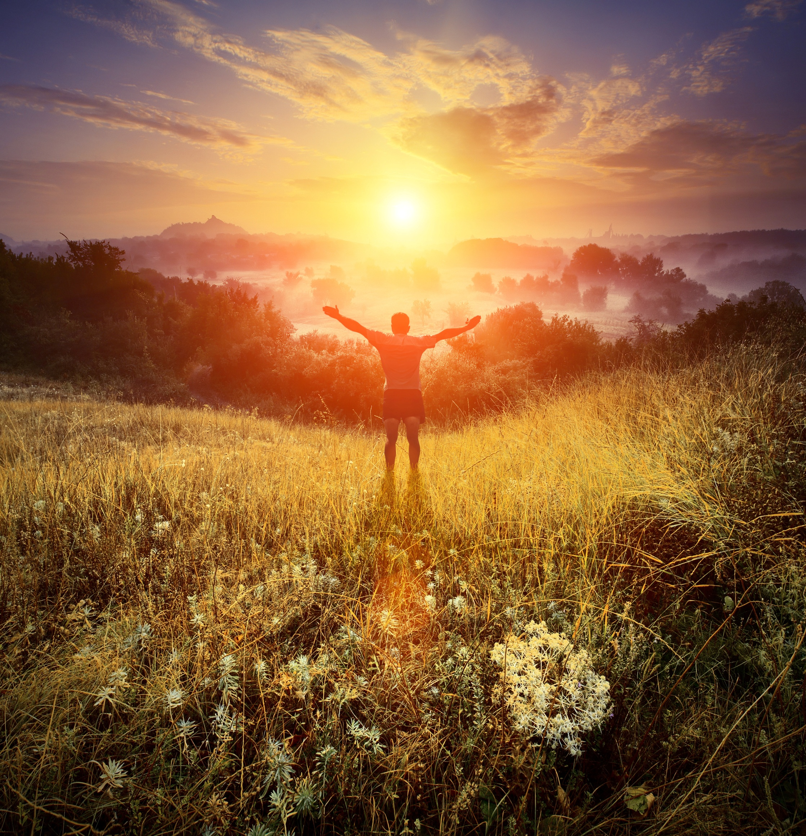
It bears repeating. Gratitude is the key to directing abundant energy! So begin now to consciously express gratitude for your world, your creation

Slide 29
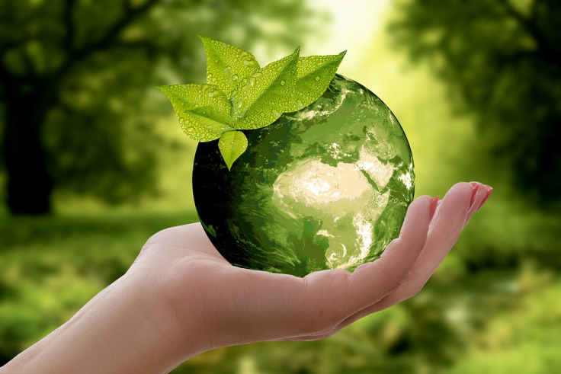
LOVE IS THE PRINCIPLE OF ABUNDANCE
When we select peace joy, serenity, and love,
we manifest it in abundance. Be in alignment with life.
Withhold love from no one – yourself or others

Slide 30
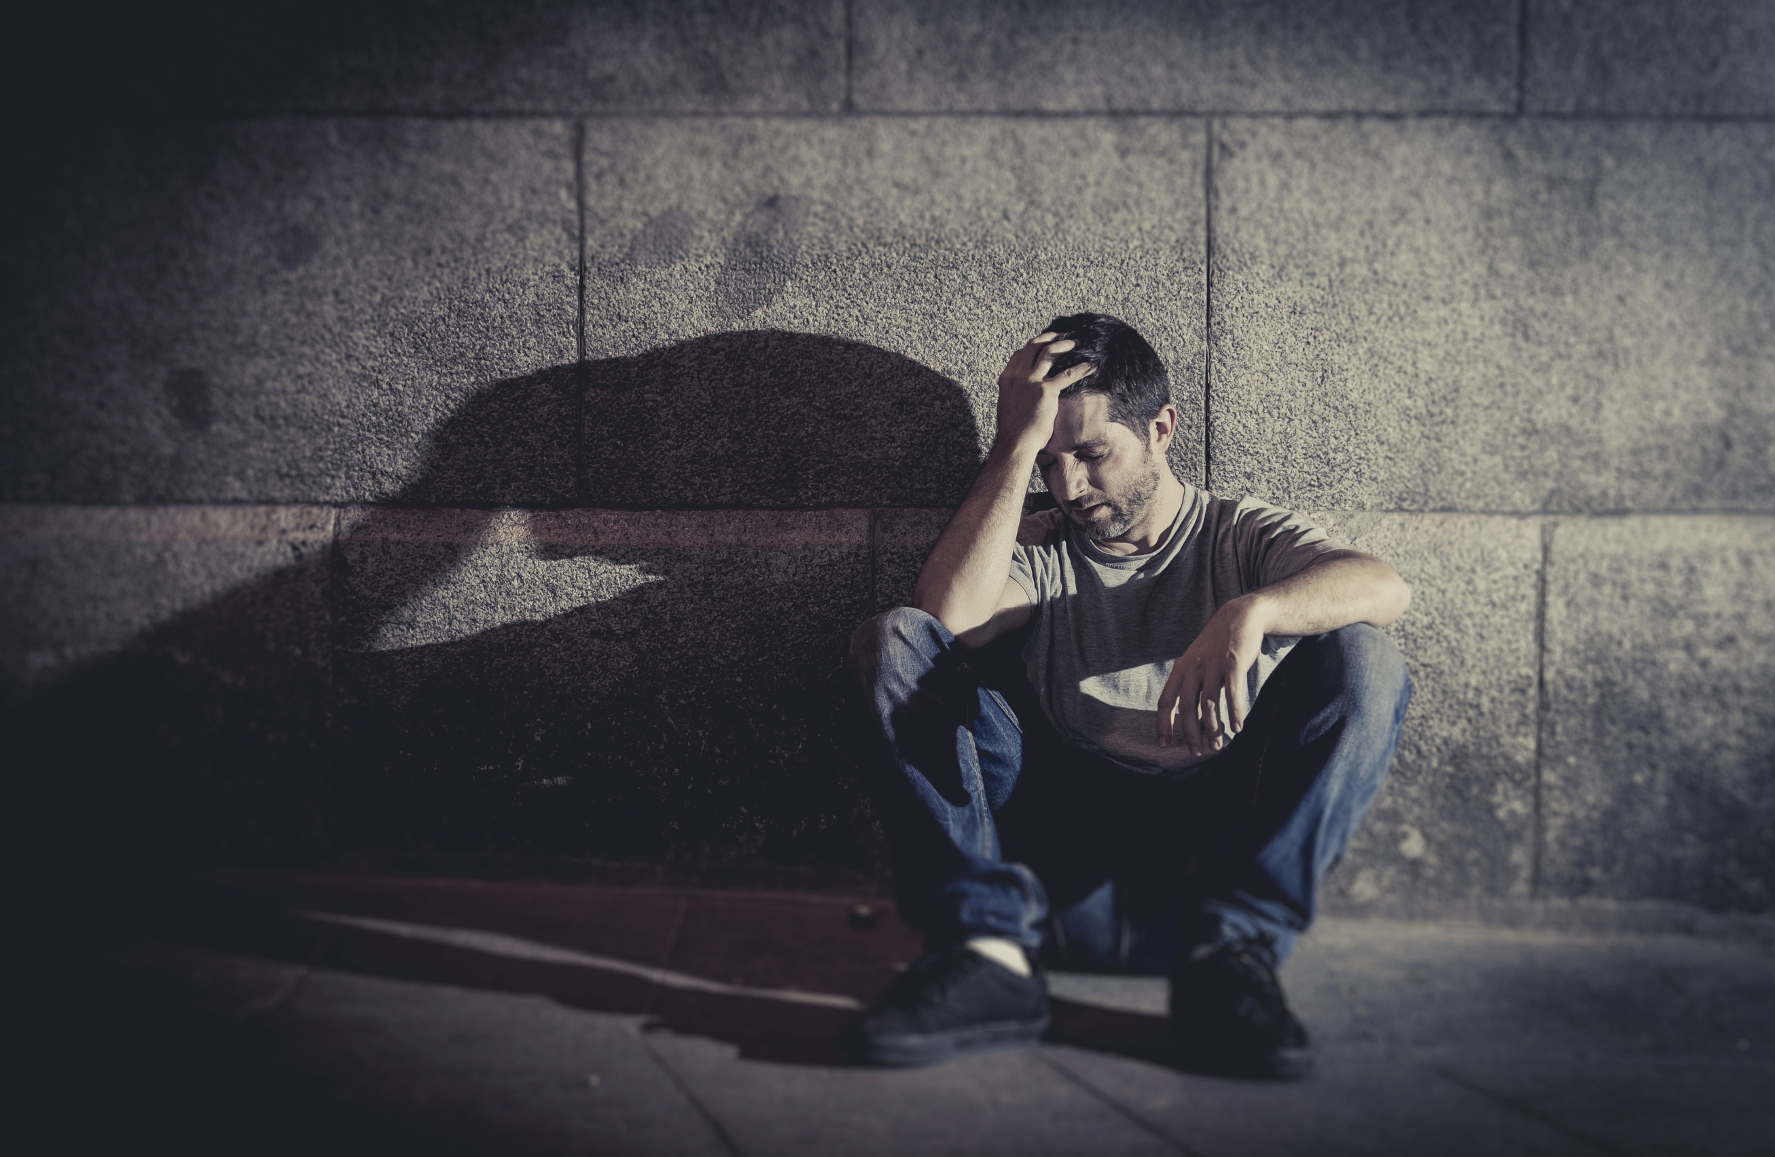
The principle that we always receive what we believe is RELENTLESS
It is in constant operation whether we notice it or not

Slide 31
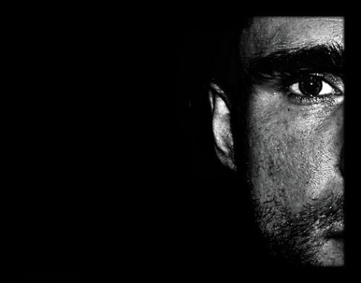
The common belief that when good things happen,
bad things
will follow, is a harmful superstition.

Slide 32
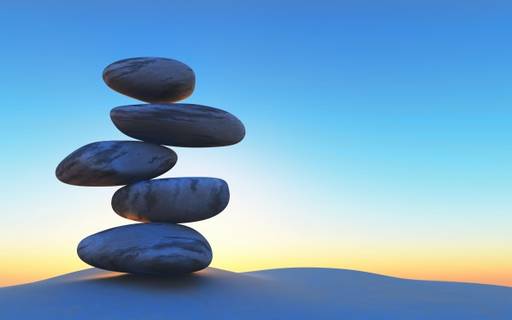
If you must believe in positive = negative for life to be in balance ~
Consider the possibility that you’ve been through all the bad,
and the rest
is all good!

Slide 33
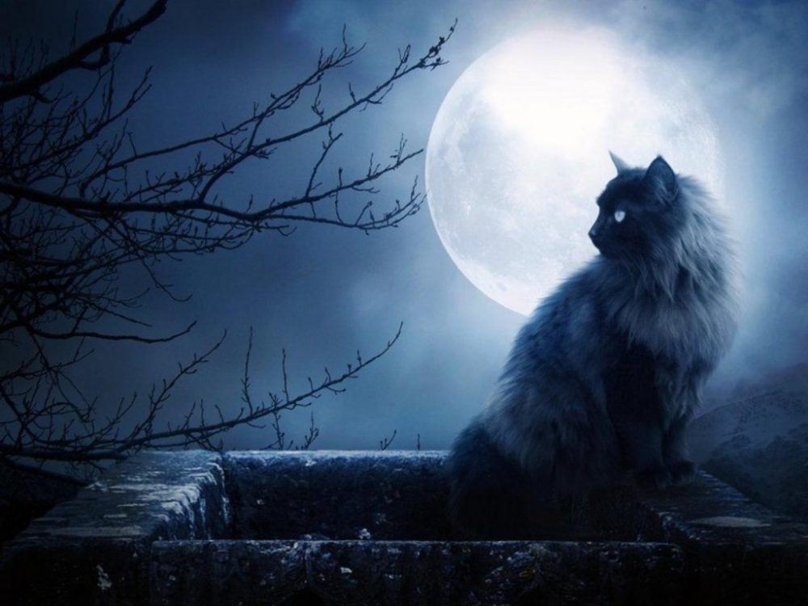
Superstitious beliefs
about money, prosperity and individual worth
are powerful cultural norms.
Examine your beliefs.
What do you
believe
you are worth?
How much do you
love yourself?

Slide 34
BELIEFS LIKE:
I have to work hard for money.
Money is a limited resource.
I can't control if I become wealthy or not.
I takes a lot of money to start a business.
Money can’t buy me happiness.
More money means more problems.
Money is the root of all evil.
I never have any extra money.
I can either make money or do what I love.
It’s not right to be rich when other people are so poor.

Slide 35
CAN BE CHANGED TO:
I do what I love; I solve problems for others and make a large profit.
There's enough money for everyone who is willing to earn it.
I create my life and take consistent actions to make it how I want it.
Starting my own business will allow me to have no limits on my income.
Money gives me the freedom to do things that improve the quality of my life.
More money means more choices in every aspect of my life.
Money is a resource to do good in my life and for others.
I manage my money because when I do, more money comes my way.
I don’t choose between making money & pursuing my passion. I do both.
I can do more for others when I’m rich than when I’m broke.

Slide 36
Abundance is measured in much more than money
We each have our own challenges to overcome.
What are yours?
Do you take good care of your body, by exercising regularly and eating for optimum wellness? Do you cook for yourself, even when you’re alone?
Do you regularly take supplements? Are you worth the cost of them?
Do you pick up after yourself, and keep your surroundings as sacred space?
Do you know how to have fun? Is your brand of fun good for you?
Do you make sure you have plenty of re-creation time?
Are you ‘other-centered’, rather than attending to your own well-being first?
Do you work too hard because you don’t know what else to do?
Do you avoid mirrors because you hate the way your body looks?

Slide 37
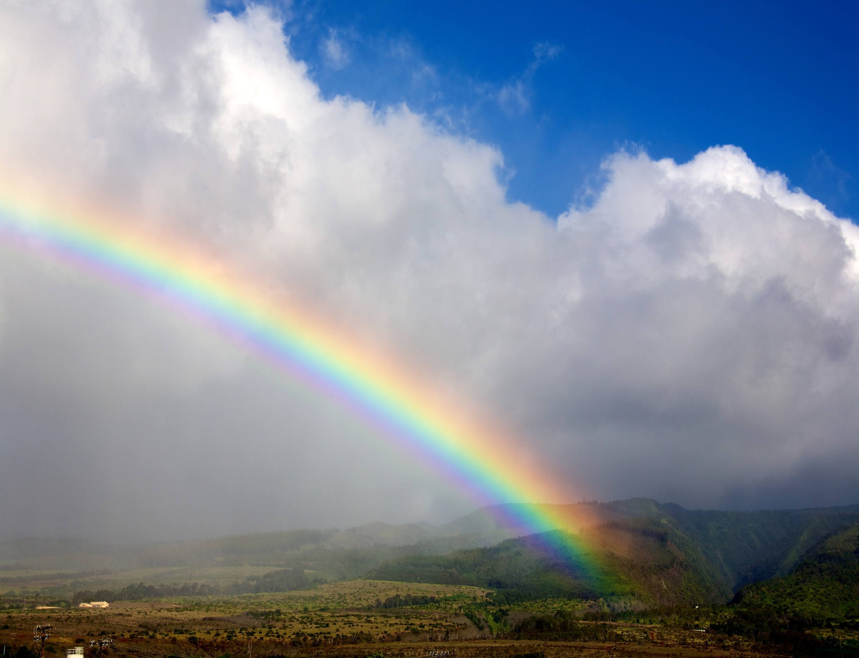
Where do we begin to overcome these lifelong habits?
FIRST Be kind to and gentle with yourself.
Give yourself credit for what you HAVE accomplished, the changes you HAVE made. All the work you’ve ever done is cumulative.
The fact that you are here means you are on the right track, facing the right direction. Now it’s time to get the broom and dustpan, and clean out the corners.

Slide 38
True to the Law of Abundance
(and dust in the corners)
There is ALWAYS MORE
So every new thought, word, and deed is a
new opportunity to choose your outcome.

